Slide 1
CHEMISTRY S5
UNIT 5. ALCOHOLS AND ETHERS

Slide 2
ALCOHOLS
Definition:
Alcohols are organic compounds containing one or more hydroxyl (–OH) groups attached to a saturated carbon atom (sp³ hybridized).
General Formula:
Monohydric alcohols: CₙH₂ₙ₊₁OH
Example: CH₃OH (methanol), C₂H₅OH (ethanol)

Slide 3
Classification:
- Primary (1°): –OH on a carbon attached to one alkyl group (e.g. ethanol)
- Secondary (2°): –OH on a carbon attached to two alkyl groups (e.g. propan-2-ol)
- Tertiary (3°): –OH on a carbon attached to three alkyl groups (e.g. 2-methylpropan-2-ol)

Slide 4
Nomenclature:
IUPAC: Replace “–e” in alkane with “–ol” (e.g. Methane → Methanol).

Slide 5
Preparation:
1. Hydration of alkenes
2. Fermentation of sugars
3. Reduction of carbonyl compounds

Slide 6
Fermentation of Sugars
Fermentation of Sugars
C₆H₁₂O₆ → 2C₂H₅OH + 2CO₂
Condition (yeast and temperature ranging 30–35°C)
C₆H₁₂O₆ = Glucose
C₂H₅OH= Ethanol

Slide 7
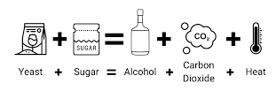
How fermentation of sugars is made?

Slide 8
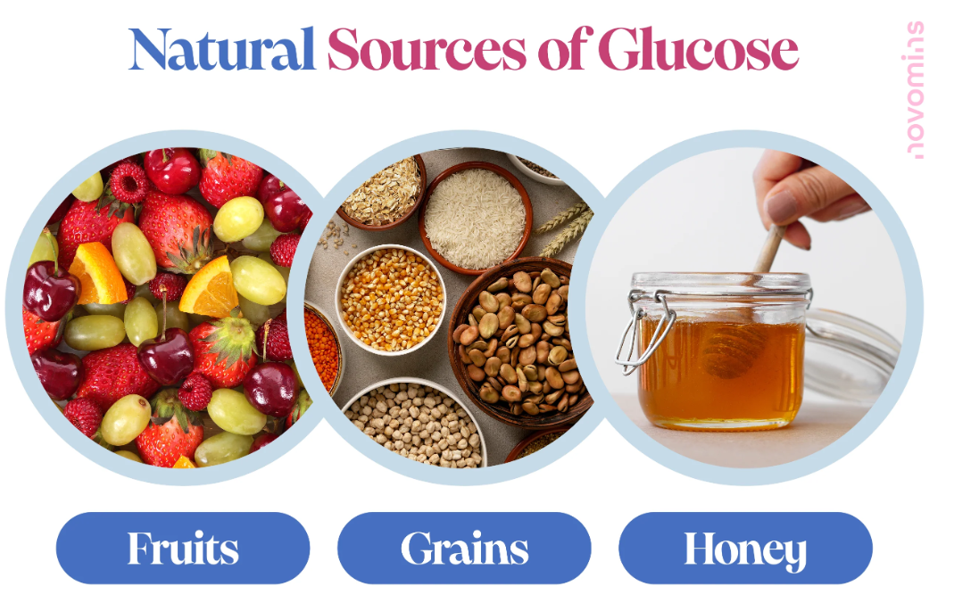
Sources of glucose

Slide 9

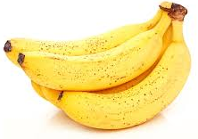
Banana

Slide 10
Physical Properties:
- Polar and form hydrogen bonds
- Higher boiling points than alkanes/ethers
- Soluble in water (small alcohols)

Slide 11
Cont’d
Alcohols are polar molecules because the oxygen atom in the hydroxyl group (–OH) is more electronegative than hydrogen, creating a partial charge separation. This polarity allows alcohols to form hydrogen bonds between the hydrogen of one molecule and the oxygen of another. As a result, alcohols have higher boiling points and are more soluble in water than hydrocarbons of similar molecular mass.

Slide 12
Chemical Properties:
1. Combustion: Alcohol + O₂ → CO₂ + H₂O
2. Dehydration: Alcohol → Alkene + H₂O
3. Oxidation: Primary → Aldehyde → Acid; Secondary → Ketone; Tertiary → No oxidation
4. Esterification: Alcohol + Carboxylic acid → Ester + H₂O
5. Reaction with Sodium: 2R–OH + 2Na → 2R–ONa + H₂

Slide 13
Uses of alcohols
- Solvents
- Fuels
- Antiseptics
- Manufacture of esters and chemicals

Slide 14
Breathalyzer ( Alcohol Test)
A breathalyzer is a device used to measure the alcohol concentration in a person’s breath to estimate blood alcohol concentration (BAC).

Slide 15

1. Principle
It works on the oxidation of ethanol (alcohol) in the breath to acetic acid — a process that produces measurable chemical or electrical changes.
The amount of ethanol in the alveolar (deep lung) air is directly proportional to the amount in the blood.

Slide 16
Types of Breathalyzers
Chemical (Color Change) Type
Fuel Cell Type
Infrared Spectroscopy Type

Slide 17
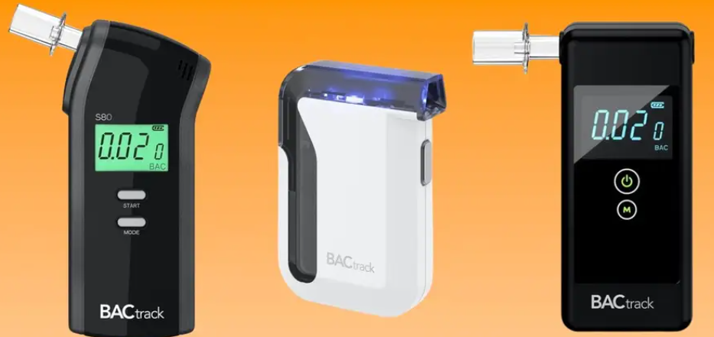

Slide 18
(a) Chemical (Color Change) Type
The person blows air into a tube containing acidified potassium dichromate (K₂Cr₂O₇) solution.
Ethanol in the breath reduces orange Cr⁶⁺ to green Cr³⁺ ions.
The color change indicates the presence of alcohol.

Slide 19

(b) Fuel Cell Type
Ethanol is oxidized at a platinum electrode to form acetic acid, protons, and electrons.
The electrons flow through a circuit, producing an electric current proportional to the alcohol concentration.

Slide 20
(c) Infrared Spectroscopy Type
Measures how much infrared light is absorbed by ethanol molecules in the breath.
When IR light passes through a sample of breath containing alcohol, certain wavelengths are absorbed by vibrating bonds — mainly around 3.4 μm (C–H stretch) and 9.5 μm (C–O stretch).
The amount of absorption corresponds to the ethanol concentration.

Slide 21
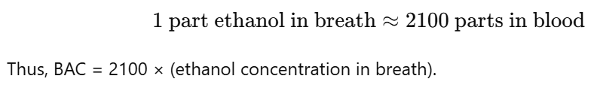
Output
The device calculates Blood Alcohol Concentration (BAC) using the ratio:

