Slide 1
SUBJECT: BIOLOGY
LEVEL: Senior Two
ACADEMIC YEAR: 2024-2025
By ISAAC

Slide 2
Lesson 1: General characteristics of animals: OBSERVE THE FOLLOWING PICTURE AND ANSWER THE QUESTIONS THAT FOLLOW:
1. What are you observing on this picture?
2. What common feature are they sharing ?
3. By using their numbers, how can you group individuals on this picture?
4. What are the main characteristics of animals?
Key question:
What makes organism an animal?

Slide 3
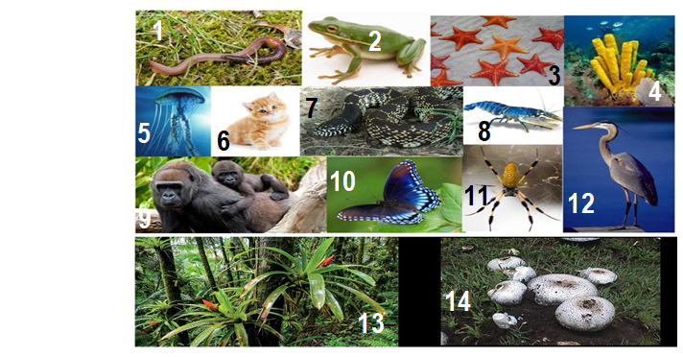

Slide 4
EXPECTED Answers
1. We are observing living things/animals, plants and fungi
2. They are all living things
3. 1-12 are animals
13 and 14 are plants and fungi respectively

Slide 5
Learning objectives:
State the characteristics of all animals.
General characteristics of animals are:
1.They are multicellular organisms.
2.They have eukaryotic cells.
3.Their cells are differentiated into tissues and organs.

Slide 6
General characteristics of animals(cont.)
4.They are all heterotrophic, meaning they depend on other organisms for food.
5.Their cells lack cell walls, cell sap and chloroplasts.
6.They only have cell membranes and this makes their cell to be irregular in shape.
7.Most animals are able to move the whole body from one place to another (locomote).

Slide 7
General characteristics of animals(cont.)
7.Reproduction in most animals takes place through fusion of gametes.
8. They respond to external stimuli: They react to external or internal change.
9. Animals do not have chlorophyll , a green pigment which captures solar energy.
10. Animals can not do photosynthesis.(They get food from other organisms).

Slide 8
Activity
Describe the main characteristics of animals?
Do all animals make movement? Justify your answer.

Slide 9
Expected answers
1. Main characteristics of animals
They get food from other organisms i.e. heterotrophs.
Most are able to move whole their body from one place to another.
They respond to external stimuli.
They are multicellular organisms (are made up of many cells)
Their bodies are differentiated into tissues and organs
2. No , because some animals such as hydra, starfish do not move.

Slide 10
Lesson 2: Phylum Chordate
The main characteristics of organisms in phylum Chordate are:
1.Presence of a chord like structure called notochord. ( A chord-like structure supports the body in lower chordates )
2. Presence of a vertebral column that protects the spinal cord.

Slide 11
The main characteristics of organisms in phylum Chordate( Cont.)
3. Presence of a nervous system with a brain which is connected to a hollow nerve tube or a single tubular nerve cord.
4.Bilateral symmetry: this means that the body can be divided along one plane into two equal halves that are roughly mirror images of each other.

Slide 12
All the animals in the picture belong to phylum chordate

Slide 13
FIVE CLASSES OF PHYLUM OF CHORDATE
1.CLASS OF FISH ( PISCES)
Main characteristics of animals in class Pisces:
All fishes are aquatic. They live in places such as seas, lakes, oceans, rivers and dams.
The skin of the fish is covered with scales which overlap backwards.
Fish have gills which are used for gaseous exchange.

Slide 14
Main characteristics of animals in class Pisces ( Cont.)
Fish have fins that aid in movement.
Fish are poikilothermic: Their body temperature is dependent on environmental temperature because they cannot regulate their own body temperature.

Slide 15
Main characteristics of animals in class Pisces ( Cont.)
Fish exhibit external fertilization where eggs are first laid by the female then the male sheds sperms over them.
Fish have a lateral line on their body for sensitivity.
Fish have a single circulatory system with a two chambered heart.

Slide 16
External features of Tilapia fish
Dorsal fin
Lateral line
Tail fin
Mouth
Operculum
Anal fin
Pelvic fin
Pectoral fin

Slide 17
Gaseous exchange in fish
Note: Fish use gills for gaseous exchange except lung fish that lives in oxygen deficient swamps and use lungs for breathing.

Slide 18
Adaptation of fish to aquatic environment. How does fish survive in water?
Fish use gills to breathe under water and the gills to allow for gaseous exchange.
Fish have a Streamlined body that allow water to easily pass over them, reducing friction (resistance) as they swim.
Fish have fins and tails that allow fish to move through water .
Fish have a hydrodynamic form that allows to swim.

Slide 19
Adaptation of fish to aquatic environment. ( Cont.)
Fish have the lateral line allows fish to detect vibrations in water, alerting them of predators.
A single fish can lay more than a million eggs, and a large number of eggs ensures that at least some will survive to maturity.

Slide 20
FIVE CLASSES OF PHYLUM OF CHORDATE
2. Class Amphibia: The word amphibia comes from the word ‘amphi’ which means ‘dual’ or ‘two’ means amphibia can live both on land and in water.
Examples of amphibia
Newt
Frog
Salamander
Toad

Slide 21
Main characteristics of animals in class Amphibia
Adult amphibians use the lungs, moist skin and mouth cavity for gaseous exchange.
The adult female amphibians always lay their eggs in water.
They exhibit external fertilization.
They have mucus glands under the skin to keep it moist.
The skin has no scales.
They have two pairs of limbs.

Slide 22
FIVE CLASSES OF PHYLUM OF CHORDATE (Cont.)
3.Class Reptilia: The term ‘Reptilia’ comes from a latin word, ‘Reptilis’ which means ‘crawl’. The animals in this class move by creeping or crawling.
Examples of reptilia snakes, turtles, tortoises, crocodiles and lizards
Tortoise
Crocodile

Slide 23
Main characteristics of animals in Class Reptilia
They have a dry scaly skin which reduces water loss.
They undergo internal fertilization. The eggs laid thereafter are covered with a shell.
They have a dry skin that can not be used for respiration.
All breathe with lungs.
They are ectotherms: Means body temperature depends on environment. Reason why bask in sunny to regulate body temperature.
They lay eggs on land.
They are poikilotherms: Body temperature varies.

Slide 24
Main characteristics of animals in Class Reptilia
Briefly
Reptiles are vertebrates. They have backbones.
Their bodies are completely covered with scales.
They are cold-blooded.
Reptiles produce shelled eggs or bear live young.
All species fertilize eggs internally.
All species of reptiles have at least one lung.

Slide 25
FIVE CLASSES OF PHYLUM OF CHORDATE (Cont.)
4.Class Aves (birds) :The term ‘aves’ comes from a Latin word ‘Avis’ which means bird.
Examples of aves

Slide 26
Main characteristics of Class Aves
Their bodies are covered with feathers.
Their legs are covered with scales.
Their front limbs are modified to form wings.
They have hollow bones that make them light for flight.
They lay eggs with a hard shell made of calcium.
They carry out internal fertilization.

Slide 27
Adaptations of birds to their environment
The forelimbs of birds are modified to form wings for flight.
Flight birds are light in weight. Their bones are air-filled.
Birds lay eggs with hard calcareous shells to avoid drying out.
The beaks of birds are modified for different modes of feeding.

Slide 28
Adaptations of birds to their modes of feeding.
Seed eaters : Like sparrows have short thick conical bills for cracking seeds.
Flesh meat eating birds: Like hawks have sharp curved beaks for tearing meat.
Nectar eating birds :Like humming birds have long slender beaks to probe the flowers.

Slide 29
Adaptations of birds to their modes of feeding.
Filter feeders : Have serrated beaks to filter food from muddy water.
Water plant eaters : Like ducks have flat beaks to strain small plants and animals from the water

Slide 30
Birds have different types of feet to adapt them to their different environments
Feet for grasping :They are large and curved to grasp a prey tightly.
Feet for scratching – like those of chickens. They have nail-like toes to scratch the soil for food.

Slide 31
Birds have different types of feet to adapt them to their different environments
Swimming birds – like ducks have webbed feet used like paddles.
Feet for running – like those of ostrich. They have three toes to enable stability when running.

Slide 32
FIVE CLASSES OF PHYLUM OF CHORDATE (Cont.)
5.Class Mammalia.
The term Mammalia is derived from the Latin word ‘mammalis’ which means ‘mammal’ or ‘mamma’ which means milk secreting organ of female mammals.
Most mammals are terrestrial except a few like dolphins and whales which are aquatic.

Slide 33
Main characteristics of animals in Class Mammalia
They have mammary glands. They suckle and take care of their young ones.
Their bodies are covered with fur, hair or wool.
They have external ears
They exhibit internal fertilization .

Slide 34
Main characteristics of animals in Class Mammalia
They are Homeothermic. Their body temperatures do not depend on the environment. It is maintained constantly.
They are heterodonts. ( Have teeth that have different shapes)
They warm blooded animals:

Slide 35
Activities :
List any five common features common to animals in phylum chordate.
Illustrate the five classes of animals in this phylum chordate.

Slide 36
Expected answers:
Organisms in the phylum Chordata ​share the following features:
Presence of notochord
Presence of nervous system
Bilateral symmetry
Vertebral column
2. Classes of Phylum Chordata are :
Pisces (fishes)
Amphibia ,
Reptilia ,
Aves (birds) and
Mammalia

Slide 37
LESSON 3: Phylum Arthropoda
Learning objectives
1.Explain the economic importance of arthropods to humans.
2. Identify classes of arthropods.
Arthropods are animals with jointed appendages.
Examples of arthropods:

Slide 38
Main characteristics of organisms in phylum Arthropoda
1.They have jointed legs (appendages).
2.They have a tough coat (exoskeleton) or covering made of chitin. It is shed in a process of moulting to allow the organism to grow. It protects internal organs against damage.
3.Their bodies are segmented.
4.Muscles for movement are attached on exoskeleton.
5.They have bilateral symmetry. This means that they can be cut into two similar halves in only one way

Slide 39
The 5 classes of phylum Arthropoda are:
1.Class Insects: The body are divided into three distinct parts; that is head, thorax and abdomen.
Ex:

Slide 40
Main characteristics of organisms in class Insecta
Their body is divided into head, thorax and abdomen.
They have a pair of long antennae.
They have three pairs of jointed legs, which are attached to their thora
They have one pair of large compound eyes.
They breathe by means of spiracles, which are found on the sides of the abdomen and thorax.

Slide 41
Main characteristics of organisms in class Insecta
Some have one or two pairs of wings that are attached to the thorax.
Antenna
Head
Thorax
Jointed legs
Compound eye
Abdomen

Slide 42
The 5 classes of phylum Arthropoda are:
2.Class Arachnida
This class of arthropods includes spiders, mites, ticks and scorpions.

Slide 43
Main features (Characteristics) of organisms in class Arachnida
The body is divided into two parts: cephalothorax and abdomen. The head and thorax are joined to form a cephalothorax.
They have four pairs of jointed legs attached to the cephalothorax.
They do not have antennae
They posses a pair of poison glands called chelicerae.

Slide 44
The 5 classes of phylum Arthropoda are:
3.Class Crustacea: Their body is divided into two parts: the cephalothorax and the abdomen.
Crab
Lobster
Crayfish

Slide 45
Main characteristics of organisms in class Crustacea
1.They have two pairs of antennae.
2.have ten or more legs.
3.They breathe by use of external gills.
4.Their body is divided into two parts: the cephalothorax and the abdomen.
The cephalothorax is covered by a shiny coat known as carapace.

Slide 46
The 5 classes of phylum Arthropoda are:
4.Class Diplopoda: Diplopoda means arthropods with two pairs of legs per segment. They also have elongated cylindrical bodies. The feeding habit or trophic level of diplopods like millipede is herbivore.
Body segments
A pair of antenna

Slide 47
Main characteristics of organisms in class Diplopoda
They have elongated and cylindrical bodies.
Their bodies are divided into two main parts; the head and a segmented trunk.
They have a pair of antennae.
They breathe through spiracles found on the sides of the body segments.
Each body segment has two pairs of legs except the first thoracic segments that have one pair of leg each.

Slide 48
The 5 classes of phylum Arthropoda are:
5.Class Chilopoda :They carnivorous animals that have flat bodies. Ex a centipede

Slide 49
Main characteristics of organisms in class Chilopoda
They have flat bodies.
They have a pair of legs in each segment.
Their body is divided into a head and a segmented trunk.
They are carnivorous.
They breathe through spiracles found on each side of the body segments.

Slide 50
Economic importance of arthropods to human.
Some arthropods are useful in many ways, for example:
1.Butterflies and bees act as pollinators of flowering plants.
2.Bees make honey.
3.Lobsters, crab and prawns are used as food.
4.They are used in scientific research.

Slide 51
Harmfulness of arthropods
Some arthropods are harmful to other living organisms, for instance:
Ticks transmit diseases in animals.
Mosquitos transmit malaria.
Tsetse flies transmit trypanosomiasis.
Aphids destroy crops such as maize, coffee and cassava.
Desert locusts ( inzige) destroy crops.

Slide 52
Other Phyla belonging to Kingdom Animalia
Lesson 4: Phyla in the kingdom Animalia.
Learning objectives:
Distinguish different groups of animals using observable features.
1.Platyhelminthes
2. Nematoda
3. Annelida
4.Mollusca
5. Coelenterata

Slide 53
Other Phyla belonging to Kingdom Animalia
1.Phylum of Platyhelminthes: Have flattened bodies,
Mainly hermaphroditic, Have a mouth but no anus.
Ex: Tapeworm, liver flukes, flat worms and planaria

Slide 54
Other Phyla belonging to Kingdom Animalia
2. Phylum of Nematoda: They Rounded unsegmented body: Round worms, hook worms, ascaris spp

Slide 55
Other Phyla belonging to Kingdom Animalia
3.Phylum of Annelida: Their bodies have segments, they have no legs,
Examples : Earthworms, lung worms, leech
4.Phylum of Mollusca:
Have sensitivity structures called tentacles on which eyes are located.

Slide 56
Other Phyla belonging to Kingdom Animalia
The dorsal side of the body is covered by a hard external shell; although some Molluscs do not have a shell.
The ventral side of the body has one soft muscular foot adapted for movement, attachment to surfaces and food capture.

Slide 57
Other Phyla belonging to Kingdom Animalia
5.Phylum of Coelentreate (cnidarian):Their body has radial symmetry and posses tentacles.
Ex:The sea anemones, hydra and jelly fish
6.Phylum of porifera:
They lack a nervous system.
They attach themselves on rocks.
Ex: Sponges

Slide 58
Other Phyla belonging to Kingdom Animalia
6.Phylum of Echinodermata:
Their skin has calcareous exoskeleton and spines.
Body of the larva has bilateral symmetry while adult body has a five-way radial symmetry (pentaradiate).
Ex: The starfish

Slide 59
Unit 2: Introduction to environmental Biology.
Lesson 1: Biosphere , ecosystem , community, habitat, population, ecological niche, Species, biotic and abiotic factors.
Learning objectives
Define terms used in ecology.
What do you observe in the figures below?

Slide 60
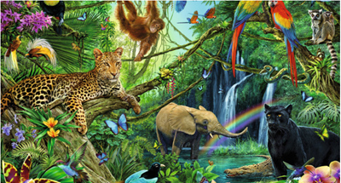
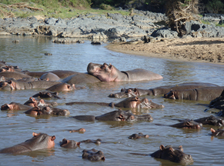
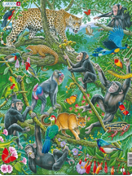

Slide 61
Terms used in ecology.
1.Ecology refers to scientific study of relationships between organisms and their environment.
2.Community: A combination of different species of organisms living together in an area.
3.Ecosystem: Communities interacting with each other and their surrounding physical environment. or Living organisms and their environment. Ex: a grassland, Desert, Lake kivu..

Slide 62
Terms used in ecology
4.Habitat: An area in which an organism lives.
5.Population: This is the total number of organisms of the same species living together in a specific area at a certain time.
6. Species refers to organisms that can reproduce among themselves.
7. Biosphere. Part of the earth where life exists.

Slide 63
Terms used in ecology.
8. Ecological niche: It is the position that an organism occupies in a habitat. Or Refers to a role /job of a species in a habitat.
9.Carrying capacity: The maximum size of a population that a given area can support without straining.
10.Producer: This refers to all green plants which manufacture their own food by the process of photosynthesis.

Slide 64
Terms used in ecology.
11. Abiotic factors
These are the environmental factors in an ecosystem. Examples : Light,Temperature ,Atmospheric pressure ,Salinity Humidity , pH and Wind .
12. Biotic factors: These are living factors.
Ex food

Slide 65
Food chains and food webs.
Lesson 2: Food chains and food webs.
Learning objectives
Construct and interpret simple food chains, food webs.

Slide 66
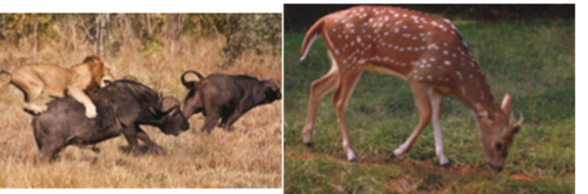
Observe carefully the figures below and answer the following questions:

Slide 67
Lesson 2: Food chains and food webs. Activity on the lesson 2:
1. What are these pictures above showing?
2. By observing the picture above, how do you think these organisms are getting energy?

Slide 68
Expected answers:
Q1. There is a lion hunting the buffalo for food in figure 1 and antelope eating grasses in figure 2.
Q2. These organisms get food from consumed food.

Slide 69
Food chains or Trophic chains
Food chain / Trophic chain: Refers to a linear representation of how organisms eat each other before they are eaten in return.
Food chain is a simple nutritional relationship among organisms where an organism has only one source of food.
Food chain is a succession of living things where one eats other before being eaten.
Food chain is a sequence describing a feeding relationship between producers and consumers.

Slide 70
Food chains or Trophic chains
Examples of food chains.
Grass Grasshopper Bird Mongoose Wild
Plant caterpillar chameleon snake mongoose
The arrow in the food chain indicate the flow of energy from the food web. or means eaten by
Trophic levels ( Feeding habits ) in food chains. A trophic level refers to the position an organism occupies in a food chain.
Producers: They are autotrophic organisms or Organisms that can make their own food.
Ex: Plant and grass
Producers get energy from the sun.

Slide 71
Food chains or Trophic chains
Primary consumers( Herbivores): Organisms that feed on plant or grasses.
Grasshopper and caterpillar.
Secondary consumers: Organisms that feed on primary consumers: Bird, chameleon
Tertiary consumers: Organisms that feed on secondary consumers. Mongoose and snake

Slide 72
Food chains or Trophic chains
What happens ( Effects) when on organism is removed from a food chain or die or attached by a strange.
Grass Grasshopper Birds Mongoose
If birds are removed or die:
Grasshopper increases, Mongoose die and grass decreases.

Slide 73
Food web/ Trophic web
Food web: A food web is a complex series of interconnected food chains.
Food web: A food web/trophic web refers to a complex nutritional relationship among organisms where an organism has different sources of food.

Slide 74
Food web/ Trophic web
Example of a food web/trophic web
Sparrow haw
Blackbird
Fox
Ladybird
Caterpillar
Hedgehog
Stoat
Greenfly
Snail
Mouse
Rabbit
Green plants

Slide 75
Food web/ Trophic web
Writing a food chain from a food web.
Example from a food web above, write a food chain of four trophic levels.
Answer:
Green plants snail Hedgehog Fox
N.B Omnivores are animals that feed on meat and plants.

Slide 76
Energy flow in ecosystems
Lesson 3: Energy flow in ecosystems
Learning objectives:
Appreciate the interdependence of living organisms.
Appreciate the role of green plants and interdependence of living organisms.
Construct and interpret pyramids of biomass and numbers.

Slide 77
Energy flow in ecosystems
Energy flows into a food chain from the sun to plants through the process of photosynthesis.
Less energy enters higher trophic levels( Some energy is lost at each trophic level)
What brings about the loss of energy at each trophic level?
Answer: Factors that cause loss of energy at each trophic level are: Respiration ,Part of the energy is lost as undigested food matter and the rest is lost as excretory products.

Slide 78
Ecological pyramids
1.Pyramid of biomass This is a representation of mass or weight of organisms in each trophic level in a food chain using a diagram.
Biomass means the dry mass of any living material at any trophic level in a food chain.
Biomass reduces as one moves from the producers to the various levels of consumers

Slide 79
Ecological pyramids
A PYRAMID OF BIOMASS
Eagle: 1kg/unit square area
Rats (2 kg square unit area
Maize (500 kg square unit area)

Slide 80
Ecological pyramids
2. Pyramid of numbers: Representation of numbers of organisms in each trophic level in a food chain.
One hawk
Four Mice
Grass plants

Slide 81
Ecological pyramids
If a tree is used as a producer, the pyramid is inverted.
Secondary consumers
Primary consumers
Producer
( Tree)

Slide 82
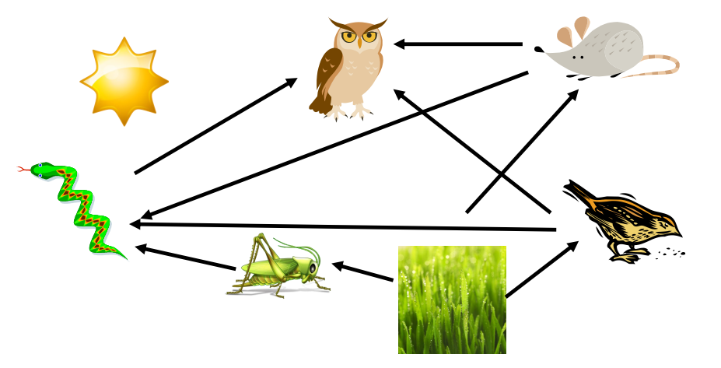
END UNIT ASSESSEMENT
1. Use the food web diagram below to answer the following questions:
D
G
E
C
B
F
A

Slide 83
END UNIT ASSESSEMENT (cont.)
What are the producers in the food web above?
What is the source of all of the energy in the food web?
Write down any food chain with three links in the food web above.
What will happen to the other organisms in the food web if all of the snakes and owls are killed by someone? Explain your answer.

Slide 84
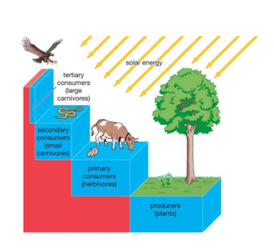
2. Observe carefully the figure bellow and answer the following questions:

Slide 85
Q3
i. The study of the interrelationships of living organisms and their environment is: A. ecosystem B. environment C. ecology ii. All the living and non-living conditions that act on an organism and affect its chances of survival is the: A. ecology B. living factor C. environment
iii. Another term meaning 'living' is: A. biology B. ecological C. biotic

Slide 86
Questions:
Define trophic level?
Identify trophic levels displayed in the figure above

Slide 87
Expected answers
1.a) Grass
b) Sun
c) - Sun grass grasshopper
sun grass mouse owl
sun grass sparrow owl
sun grass sparrow snake
d) If all the snakes and owls are killed by someone, the other organisms in the food chain will be competing more for food. There are more herbivores who will be competing for the food source (grass), which would result in the herbivores either dying of starvation or leaving
2. (i) The trophic level is the group of organisms within an ecosystem which occupy the same level in a food chain.
(ii) In the figure above, the trophic levels displayed are producers, primary consumers, secondary consumers, and tertiary consumers
3. Q i:C Q ii:C Q iii:C

Slide 88
Unit 3: Passive movement of substances across the cell membrane.
Lesson 1: Importance of diffusion of gases and solutes.
Learning objectives:
Define diffusion.
Describe the importance of diffusion.
Investigating diffusion through experiments

Slide 89
Diffusion and its importance
Substances always move into and out of the cells. The way substances move into and out of the cells depends on certain properties of the substances, for example, size of the molecule and the type of substance.
There are three main physiological processes by which substances move in and out of cells. These are diffusion, osmosis and active transport.

Slide 90
Diffusion
Diffusion: It is a movement of particles (gases, ions, solutes or molecules) form a region of high concentration to a region of low concentration along concentration gradient.
This difference in concentration between two regions is known as concentration gradient.
When the concentration gradient increases the rate of diffusion increases as well.

Slide 91
Investigating diffusion though experiments
Beaker
Water
CuSO4
Diffusing particles

Slide 92
Investigating diffusion though experiments
Water
Potassium permanganate
Diffusion in a liquid.

Slide 93
Importance of diffusion plants.
1.Importance of diffusion in plants:
Diffusion allows Plants to absorb water from the soil through the roots hairs.
Diffusion helps plants to absorb mineral salts from the soil through the roots hairs.
Diffusion allows plants to absorb oxygen from the soil through the root hairs.

Slide 94
Importance of diffusion plants.
Diffusion allows plants to absorb CO2 from atmosphere.
Diffusion allows plants to release O2 produced during photosynthesis to atmosphere through the stomata.

Slide 95
Importance of diffusion animals.
Diffusion allows gaseous exchange in skin of frogs.
Diffusion allows gaseous exchange in lungs of animals.
Diffusion allows digested food such as glucose and amino acids to move from the small intestine into the blood of animals.
Diffusion allows unicellular organisms such as Amoeba get rid of waste substances.

Slide 96
Factors that influence rates of diffusion.
Lesson 2: Factors that influence rates of diffusion.
Learning objective:
Explain the factors that influence the rate of diffusion.

Slide 97
Factors that influence rates of diffusion.
1.Diffusion distance: When the distance to diffusion is long, the rate of diffusion decreases.
It takes a longer time for molecules to diffuse across a thick membrane while It takes less time for molecules to diffuse across a thin membrane.
2. Temperature : When the temperature of particles is high, their kinetic energy increases and the particles move faster.
Therefore, the higher the temperature, the faster the particles will diffuse while the lower the temperature the lower the rate of diffusion.

Slide 98
Factors that influence rates of diffusion.
3.Concentration gradient: This is the difference in the amount of particles present in two regions.
When the concentration gradient is low, diffusion rate is also slower.
Molecules A
Molecules B
Difference in concentration gradient

Slide 99
Factors that influence rates of diffusion.
4. Size of molecules: Larger molecules are heavier and will diffuse at a slower rate compared to smaller molecules which are lighter.
5. Surface area to volume ratio :
When the surface area to volume ratio is large, more of the substance diffuses across it than when it is small.

Slide 100
Factors that influence rates of diffusion.
Small organisms such as Amoeba have a greater surface area compared to volume than larger organisms, for example human beings. Therefore, diffusion of substances into and out of smaller organisms is faster than in larger organisms.
Small organisms can absorb oxygen and other materials from the environment much more rapidly than large ones. They also can excrete waste products at a faster rate than large organisms.

Slide 101
Osmosis, turgidity, turgor pressure, plasmolysis, flaccidity and importance of water potential and osmosis.
Lesson 1, 2, 3 & 4: Osmosis, turgidity, turgor pressure, plasmolysis, flaccidity and importance of water potential and osmosis.
Learning objectives:
Define osmosis.
Describe the importance of osmosis in plants and animals.
Investigate osmosis through experiments.

Slide 102
Osmosis,
Osmosis: This refers to the movement of water molecules from a region of high water potential (dilute solution) to a region of low water potential (concentrated solution) through a partially permeable membrane.
Osmosis: This refers to the movement of water from hypotonic solution to hypertonic solution through a semi- permeable membrane.
Osmosis is the movement of water from a dilute solution to a concentrated solution through a semi-permeable membrane.

Slide 103
Diluted and concentrated solutions
A dilute solution has more water molecules compared to solute molecules whereas a concentrated solution has more solute molecules than water molecules.
Solute particles
Water
Dilute solution/Less concentrated solution
Concentrated solution

Slide 104
Investigate osmosis through experiments
Capillary tube
Concentrated salts
Visking tubing
Dilute water
Beaker

Slide 105
Investigate osmosis through experiments
Concentrated salt solution
Raw Irish potato
Distilled water
Demonstration osmosis

Slide 106
Investigate osmosis through experiments
A
B
A semi-permeable mebrane
Solute molecules
Water molecules
Water will move from A region to B region

Slide 107
Importance/Role of osmosis in plants and animals.
Role of osmosis in plants.
1.Osmosis allow uptake of water by roots:
Movement of water
Root hair
Xylem
Root epidermis

Slide 108
Turgidity
Turgidity refers to the process by which water accumulates in cell vacuoles. Plant cells are turgid allow plant to stand upright.
Vacuole
Cell membrane
Cell wall
Turgid plant cell

Slide 109
Turgidity
When a plant cell is placed in dilute solution does not burst because has a vacuole to store water. But when an animal cell is placed in dilute water bursts because it has no vacuole.
Turgidity in plant cells is important because gives support to the soft tissues such as petals and sepals.

Slide 110
PLASMOLYSIS and Flaccidity
Plasmolysis: This is the process by which the cytoplasm and vacuole loses water and shrink.
The vacuole in turn reduces in size due to losing water. The cell is said to be plasmolysed if it has lost water. When a plasmolysed cell is placed in distilled water, it will become turgid again.
Flaccidity is when a plant cell loses too much water and become flaccid.

Slide 111
PLASMOLYSIS
Cell wall
Nucleus
Vacuole shrinks
Cytoplasm
Plasmolyzed plant cell

Slide 112
Role of turgor pressure
Lesson 1, 2,3 &4 : Role of turgor pressure within cells.
Learning objective: Give the role of turgor pressure in plant cells.
As turgor pressure increases due to intake of more water by osmosis, the cell wall exerts a pressure that is equal to turgor pressure on the protoplasm called wall pressure.
Turgor pressure allows the closing and opening of stomata.
Turgor pressure regulates the loss of water.
It has been concluded that the loss of turgor pressure within the leaves of Mimosa pudica is responsible for the reaction the plant has when touched.

Slide 113
Passive movement
Osmosis and diffusion are passive movements.
Transport occurs from a high concentration of molecules and ions to low concentration, in order to maintain equilibrium in the cells.
Does not use energy.

Slide 114
Unit 4: Active transport
LESSON 1: Active transport and its importance.
Learning objectives
Define active transport.
Compare passive and active transport.
Appreciate the importance of active transport.
Describe how carrier proteins move particles across membrane during active transport.

Slide 115
ACTIVE AND PASSIVE TRANSPORT
Figure A
Figure B

Slide 116
Active transport.
Active transport is a movement of molecules and ions from an area of low concentration to that of higher concentration against a concentration gradient.
Active transport is the movement of particles through the cell membrane from a region of low concentration to a region of high concentration using energy.
Active transport requires the use of energy since particles move against a concentration gradient.

Slide 117
Comparison between active and passive transport.
Active transport
Passive transport
1.Uses energy.
2.Transport occurs from a low concentration of molecules and ions to high concentration.
3. Involves endocytosis and exocytosis processes
4.Transports anything soluble water, oxygen and carbon dioxide
1.Does not require cellular energy.
2.Transport occurs from a high concentration of solute to a low concentration of solute.
3.Involves osmosis and diffusion processes.
4.Transports proteins, ions, large cells and complex sugars

Slide 118
The role of proteins in active transport
Carrier protein molecules. They pick up molecules of a substance from one side of the cell membrane and transport them across.

Slide 119
Role of active transport in living organisms
Active transports allows root hair cells in plants absorb mineral salts and ions from the surrounding soil.
Active transport allows food molecules to be absorbed even when the concentration of these molecules is higher in the cells than in the intestinal lumen.
Active transport allow the nerve cells to absorb sodium and potassium.
Active transport allows the useful substances to be reabsorbed into the blood.

Slide 120
Factors affecting active transport.
Lesson 3 & 4: Factors affecting active transport.
Learning objectives:
Give factors that affect active transport.
Factors affecting active transport.
1.Concentration of oxygen : The higher oxygen concentration, the higher production of energy, the higher rapid active transport by the protein carriers.

Slide 121
Factors affecting active transport.
2. Concentration of glucose: The higher the concentration of glucose , the higher production of energy, the higher rapid active transport.
3. Temperature : High temperatures can destroy (denature) the protein carriers in the cell membrane. This stops active transport. Active transport works best under normal temperature which in human beings is 37ºC.
4.Enzyme inhibitors: Enzyme inhibitors reduce the rate of active transport.

Slide 122
Factors affecting active transport
5. pH : When pH Changes in the environment of the cell alters the structure of the protein carriers reducing their ability to transport molecules across the cell membrane.

Slide 123
Role of proteins in active transport across the membrane.
Lesson 1 & 2: Role of proteins in active transport across the membrane.
Proteins carriers transport molecules with the use of energy.
Protein carriers transport molecules from a lower concentration to a higher concentration.

Slide 124
Endocytosis.
Lesson 3: Endocytosis.
Learning objective:
Explain endocytosis.
Endocytosis involves the bulk uptake of materials through the plasma membrane. It takes place in two ways: phagocytosis and pinocytosis.

Slide 125
Phagocytosis
Phagocytosis :Phagocytosis means ‘cell eating.
This is intake of soli particles by the cell.
Phagocytosis

Slide 126
Pinocytosis
b) Pinocytosis : Pinocytosis means ‘cell drinking.’ This process by which the cells take in materials in liquid form.
Pinocytosis

Slide 127
Exocytosis.
Lesson 4: Exocytosis.
Learning objective:
Explain the process of exocytosis
Exocytosis is the process by which materials are removed from the cells.
Examples of exocytosis:
Secretion of digestive enzymes by pancreas.
Secretion of milk from mammary glands.
Secretion of mucus by salivary glands.

Slide 128
Exocytosis
Cell membrane
Exocytosis

Slide 129
Unit 5: Identification of food components
Lesson 1, 2, 3 & 4: Chemical tests for starch, reducing sugars, proteins, fats and vitamin C.
Learning objectives:
State the chemical reagents used in the identification of each class of food.
Carry out tests to identify food substances in a given sample.

Slide 130
Components of food substances
Food contains mainly two classes of nutrients; organic substances such as proteins, carbohydrates, lipids and vitamins and inorganic nutrients include mineral salts like calcium, phosphorous and others like water.
N.B Food testing can be done to confirm the presence of starch, reducing sugars, proteins, fats and vitamin C in a food sample.

Slide 131
Types of carbohydrates
1.Monosaccharides ( Reducing sugars): Simple sugars with general formula ( CH2O), soluble in water and sweet.
Ex: Glucose, Fructose, Galactose.
2. Disaccharides ( Non-reducing sugars): Double sugars formed by condensation of two molecules of monosaccharides sugars.
Ex: Sucrose, Maltose and Lactose.
3.Polysaccharides: These are complex , long chains of monosaccharide molecules, insoluble in water and not sweet.
They are suitable for storage in living cells.
Ex: Starch, Glycogen, Cellulose.

Slide 132
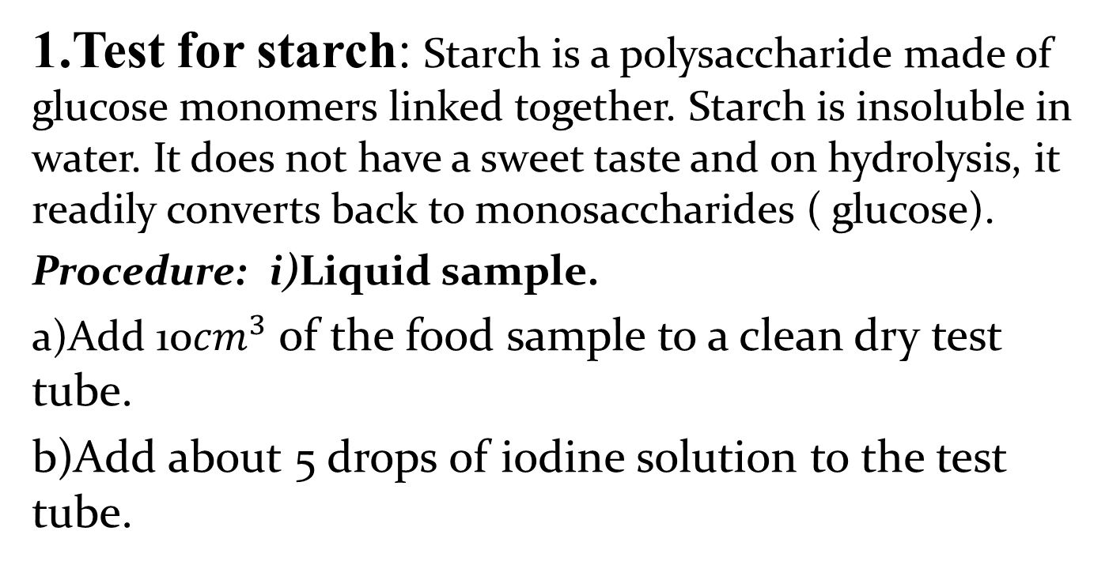
Test for starch
1.Test for starch: Starch is a polysaccharide made of glucose monomers linked together. Starch is insoluble in water. It does not have a sweet taste and on hydrolysis, it readily converts back to monosaccharides ( glucose).
Procedure: i)Liquid sample.
a)Add 10${cm}^{3}$ of the food sample to a clean dry test tube.
b)Add about 5 drops of iodine solution to the test tube.

Slide 133
Test for starch
Observations:
For a positive result: ( If starch is present)
The colour of Iodine(brown) turns from brown to blue-black if starch is present.
For a negative result( If no starch present)
If there is no starch in the food sample, the brown colour of iodine persists.

Slide 134
Test for starch
Starch gives a blue-black colour with Iodine solution.

Slide 135
Test for starch
ii)Test for starch in solid sample.
Procedure:
Peel off the skin of sugar containing food
( potato)
b)Use spatula to remove samples of powdered food.
(Avoid cross contamination with other food).
c) Add a few ( 2-3) drops of iodine to a piece of solid.
Observation: Color changes from brown to blue back if starch is present.

Slide 136
Reducing and non-reducing sugars
Based on their reaction with Benedict’s solution sugars are grouped into two.
1.Reducing sugars: These are good reducing agent. Ex: Glucose, lactose, fructose, maltose and galactose. They are sweet and soluble in water.
2.Non-reducing sugars: They are non reducing sugars: Ex Sucrose
Non -reducing sugar reduces copper in blue copper sulphate to red copper oxide.

Slide 137
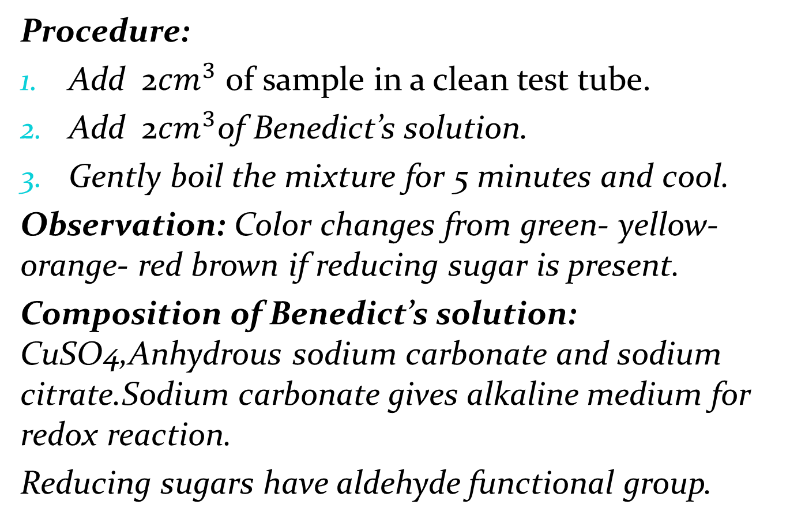
Test for reducing sugars
Procedure:
Add 2${cm}^{3}$ of sample in a clean test tube.
Add 2${cm}^{3}$of Benedict’s solution.
Gently boil the mixture for 5 minutes and cool.
Observation: Color changes from green- yellow-orange- red brown if reducing sugar is present.
Composition of Benedict’s solution: CuSO4,Anhydrous sodium carbonate and sodium citrate.Sodium carbonate gives alkaline medium for redox reaction.
Reducing sugars have aldehyde functional group.

Slide 138
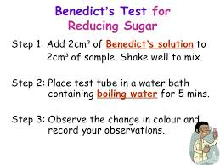
TEST FOR REDUCING SUGAR BY BENEDICT’S TEST

Slide 139
TEST FOR SUGAR
When Benedict solution boiled with glucose, which is a reducing sugar, an orange precipitate forms.
When Benedict’s solution, which is blue in colour, is boiled with substances with non-reducing sugar such as sucrose, its blue colour persists.

Slide 140
Observation during Benedict test
By Benedict solution, the colour change from blue to green, yellow and finally red indicates the presence of reducing sugar. The colour changes depend on the amount of reducing sugars present.
Green colour indicates small amounts of reducing sugars.
Yellow/orange shows high levels of reducing sugars.

Slide 141
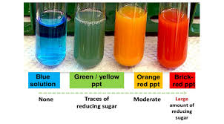
Observation during Benedict test

Slide 142
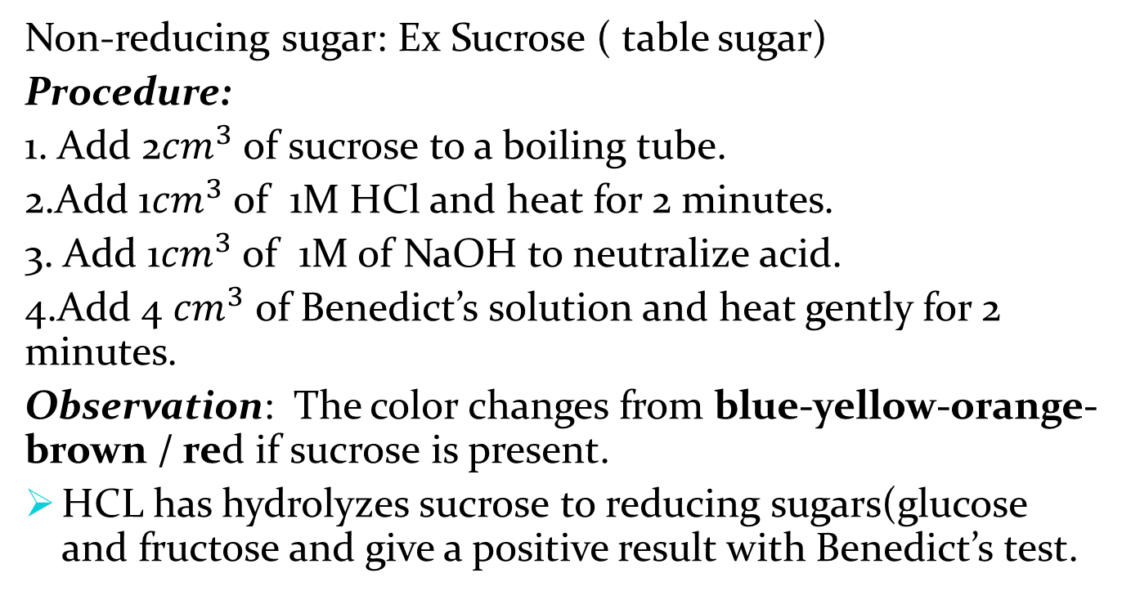
Test for non reducing sugar.
Non-reducing sugar: Ex Sucrose ( table sugar)
Procedure:
1. Add 2${cm}^{3}$ of sucrose to a boiling tube.
2.Add 1${cm}^{3}$ of 1M HCl and heat for 2 minutes.
3. Add 1${cm}^{3}$ of 1M of NaOH to neutralize acid.
4.Add 4 ${cm}^{3}$ of Benedict’s solution and heat gently for 2 minutes.
Observation: The color changes from blue-yellow-orange-brown / red if sucrose is present.
HCL has hydrolyzes sucrose to reducing sugars(glucose and fructose and give a positive result with Benedict’s test.

Slide 143
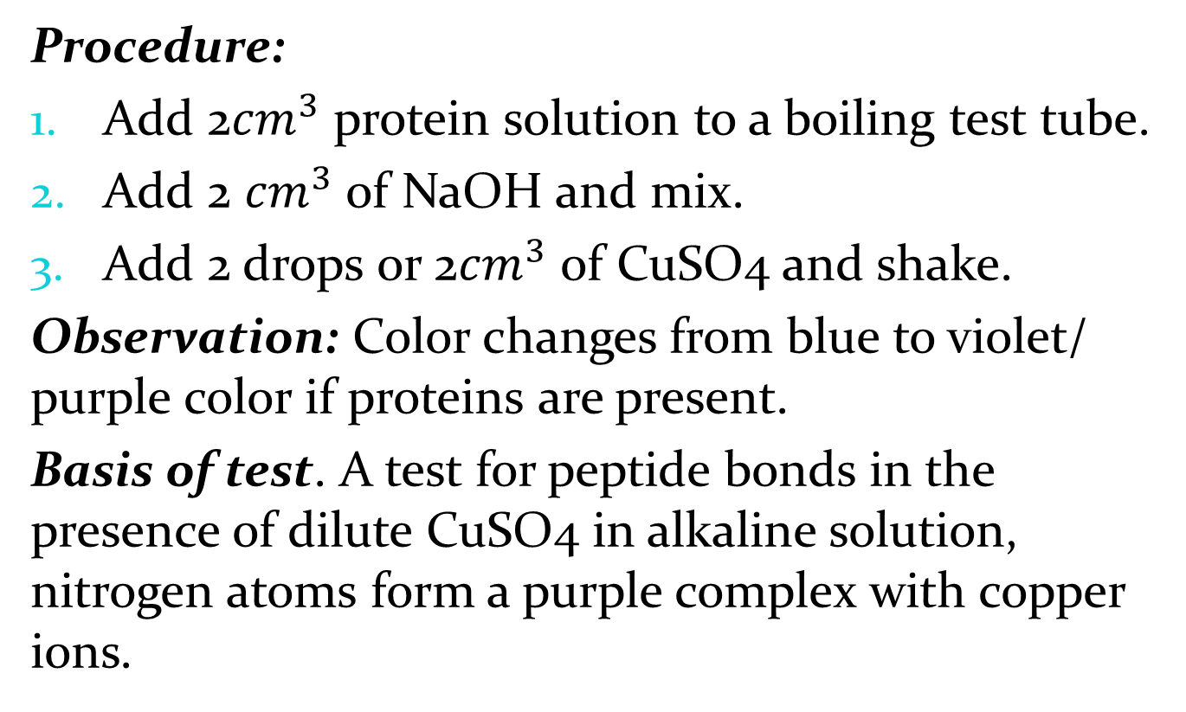
Test for proteins( Biuret Test)
Procedure:
Add 2${cm}^{3}$ protein solution to a boiling test tube.
Add 2 ${cm}^{3}$ of NaOH and mix.
Add 2 drops or 2${cm}^{3}$ of CuSO4 and shake.
Observation: Color changes from blue to violet/ purple color if proteins are present.
Basis of test. A test for peptide bonds in the presence of dilute CuSO4 in alkaline solution, nitrogen atoms form a purple complex with copper ions.

Slide 144
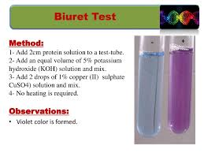
Observation during protein test by Biuret test.

Slide 145
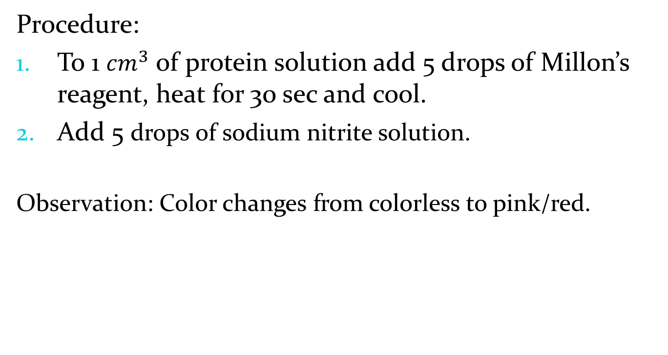
Test for proteins Using Millon’s reagents
Procedure:
To 1 ${cm}^{3}$ of protein solution add 5 drops of Millon’s reagent, heat for 30 sec and cool.
Add 5 drops of sodium nitrite solution.
Observation: Color changes from colorless to pink/red.

Slide 146
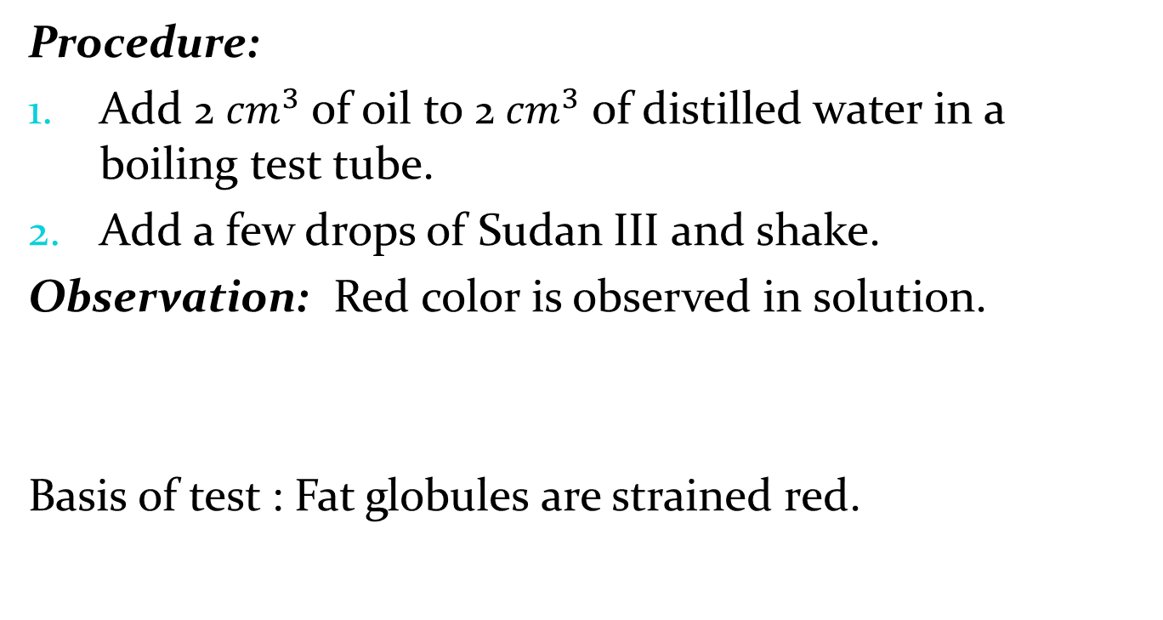
Test for lipids
Procedure:
Add 2 ${cm}^{3}$ of oil to 2 ${cm}^{3}$ of distilled water in a boiling test tube.
Add a few drops of Sudan III and shake.
Observation: Red color is observed in solution.
Basis of test : Fat globules are strained red.

Slide 147
TESTING FOR VITAMIN C
A reagent known as Dichlorophenol indophenol (DCPIP) is used to test for vitamin C. DCPIP is a deep blue reagent in colour.
When vitamin C is present in a food sample, the blue colour disappears (decolourised).
Examples of food containing vit C.
Water melon

Slide 148
UNIT 6: ENZYMES
Lesson 1: Catalyst and enzymes.
Learning objectives:
Define the term catalyst and enzyme.
Describe why enzymes are important in all living organisms.

Slide 149
CATALYST
Catalyst refers to simple inorganic molecules used to increase or decrease the rate of a chemical reaction but remain unchanged.
Ex: Vanadium oxide, Platinum (Pt)
Properties of catalysts:
They are inorganic molecules
They have low molecular weight.
They stay unchanged after the reaction.
They do not have covalent bonds in their structure.

Slide 150
ENZYMES.
Enzymes are biological catalysts and protein in nature.
Ex: Salivary Amylase, Lipase, Pepsin, Pancreatic amylase.
Function or role of enzymes:
They speed up or slow down the rate of chemical reactions in the body without being changed. It means that Enzymes do not change after the reaction.

Slide 151
TYPES OF ENZYMES
Intracellular enzymes: Those are Enzymes are used within the cells that produce them.
Ex: Respiratory enzymes
b) Extracellular enzymes: Enzymes are transported from the cells that produce them to be used in other cells.
Ex Pancreatic amylase, Salivary amylase.

Slide 152
Types of enzymes
There are also different types of enzymes based on the foods they act on, for example:
Peptidases: Break down proteins
Lipases: Break down lipids
Carbohydrases: Break down carbohydrates

Slide 153
Sites of production and function of enzymes
Enzyme+ Sites of production
Function/role
Salivary amylase is produced by salivary glands( mouth).
Pepsin: It is produced by the stomach.
Rennin: Produced by the stomach
Pancreatic amylase produced by pancreas
Pancreatic lipase: Produced by pancreas
Digests starch or glycogen into maltose.
Digests proteins into dipeptides
It ensures coagulation of milk
Digests maltose into glucose.
Digests lipids into fatty acids and glycerol.

Slide 154
Characteristics or properties of enzymes.
Lesson 2 ,3&4: Characteristics of enzymes.
Learning objectives:
Explain the characteristics of enzyme.
1. Enzymes are protein in nature: All enzymes are made up of proteins and have covalent bonds in their structure.

Slide 155
Characteristics or properties of enzymes
2.Enzymes are affected by temperature. They work best at specific temperatures; for example, enzymes found in human bodies work best at 37oC. This is called the optimum temperature.
Optimum temperature of an enzyme is the temperature at which that enzyme works best.

Slide 156
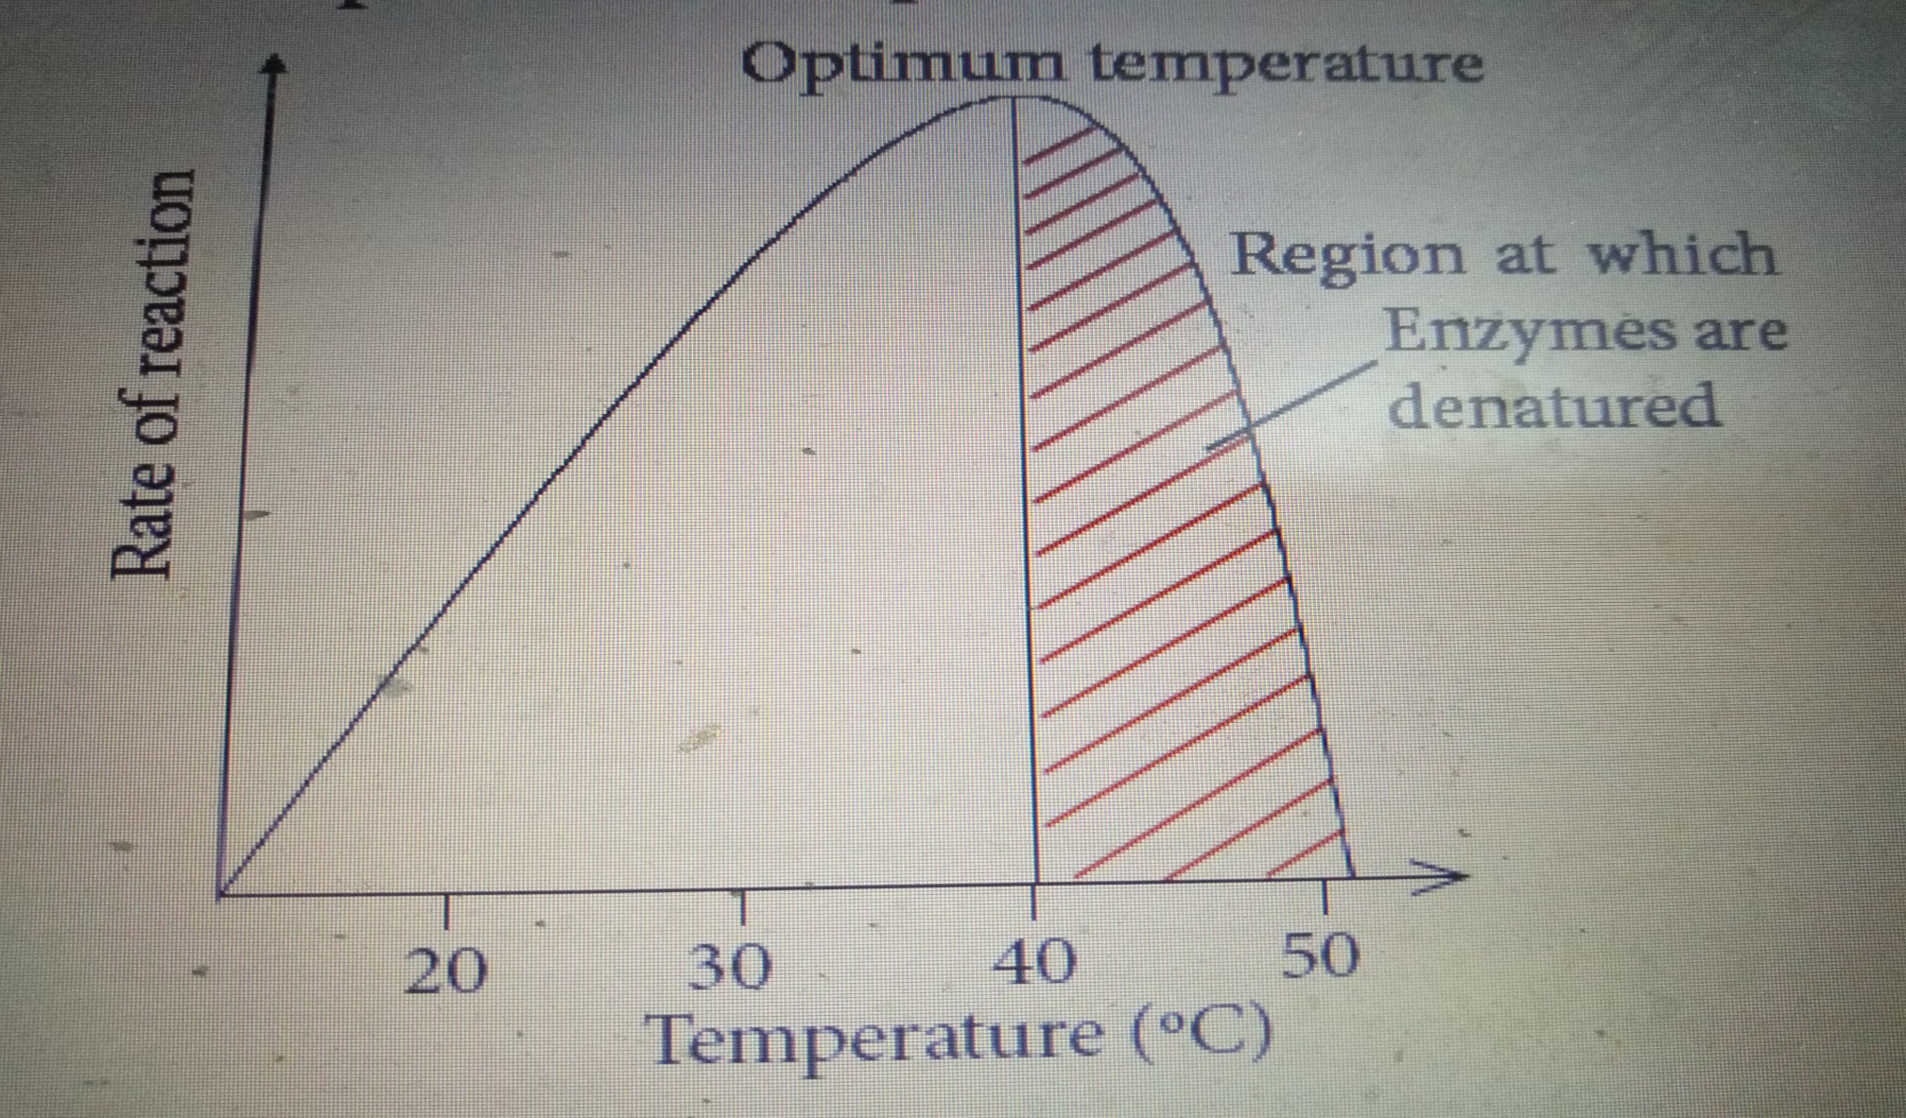
Characteristics or properties of enzymes

Slide 157
Characteristics or properties of enzymes
Very low temperatures inactivate enzymes. Therefore enzymes are not able to catalyze reactions.
High temperatures beyond the optimum temperature denature enzymes. The structure of the protein molecule is destroyed by heat.

Slide 158
Characteristics or properties of enzymes
3. Enzymes work best at specific pH. Different enzymes have a given specific pH at which they act best.
The optimum pH of an enzyme is the PH at which an enzyme works best. ( produces large amount of products)
Ex: Optimum pH of pepsin in the stomach is 2 because the stomach medium is acidic.

Slide 159
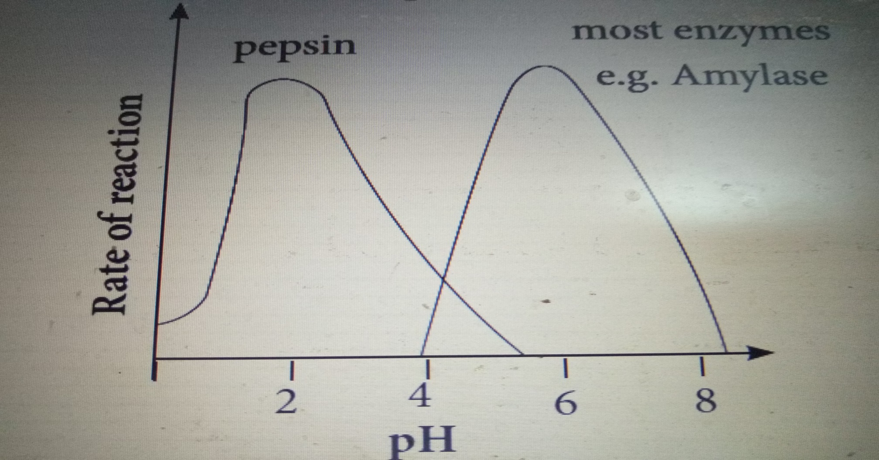
Characteristics or properties of enzymes

Slide 160
Characteristics or properties of enzymes
4.Enzymes remain unchanged after catalyzing a reaction. Enzymes are catalysts and can therefore be used over and over again in small amounts without being changed.
5.Enzymes catalyze reversible reactions. This means that they can change a substrate into products and the products back to the original substrate.
A + B C

Slide 161
Characteristics or properties of enzymes
6. Enzymes are substrate-specific. Each enzyme has only one substrate to act on. It means an enzyme acts as a key and lock. This means they have active sites which can only fit to a particular substrate whose shape complements the active site.
For example, pepsin works on proteins but not on fats or starch.

Slide 162
Characteristics or properties of enzymes
7. Enzymes work rapidly. Enzymes work very fast in converting substrates into products.
The fastest known enzyme is catalase.
Hydrogen peroxide catalase water + oxygen
2H2O2 (aq) catalase 2H2O (l) + O2 (g)

Slide 163
Factors affecting enzyme activity.
Lesson 1, 2, 3 & 4: Factors affecting enzyme activity.
Learning objective:
Explain the factors that affect enzyme activity.
Draw and interpret graphs for the rate of enzyme activity.
Enzymes are protein in nature and are very sensitive so activity of enzymes depends on different factors.

Slide 164
Factors affecting enzyme activity.
Factors that affect enzyme activity are:
Temperature
pH
Enzyme concentration.
Substrate concentration.
Presence of inhibitor.
Surface area.

Slide 165
Factors affecting enzyme activity.
Each enzyme has its own temperature at which enzymes work best is called optimum temperature.
Temperatures lower than the optimum cause enzymes to be inactive. Therefore they work at a slow rate.
Temperature beyond the optimum cause enzymes to be denatured/ destroyed and the rate of reaction slows down.

Slide 166
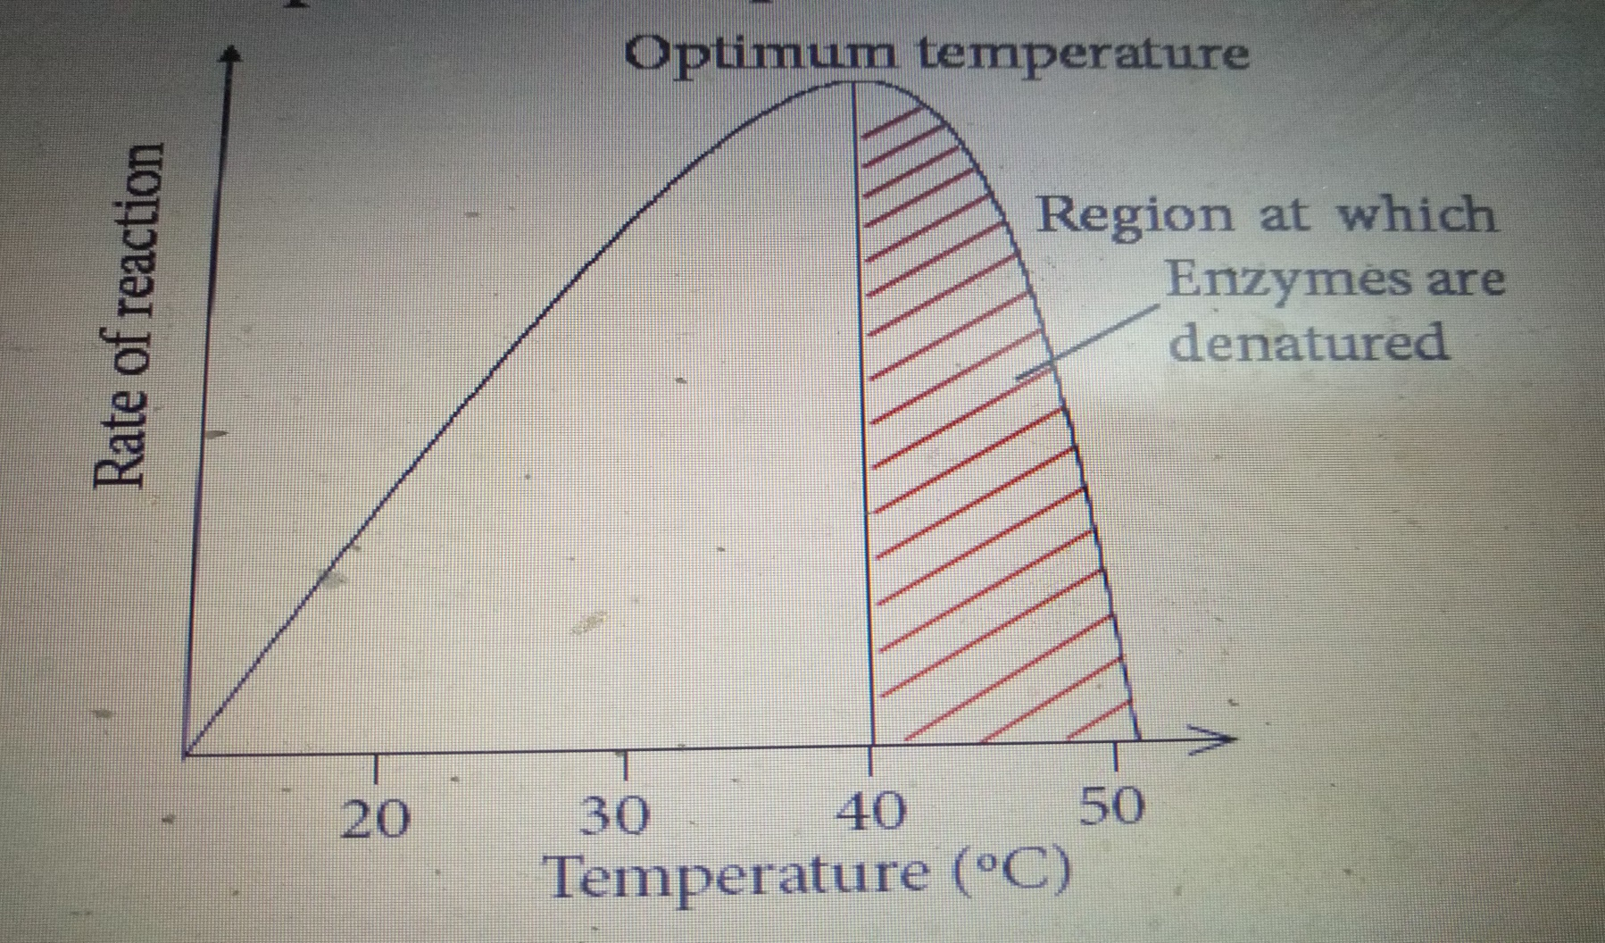
Factors affecting enzyme activity.

Slide 167
Factors affecting enzyme activity
b) pH:
Each enzyme has an optimum pH, at which it works best.
Ex: Pepsin digests proteins in the stomach at a pH of 2 while trypsin digests proteins in the duodenum at a pH of 9.

Slide 168
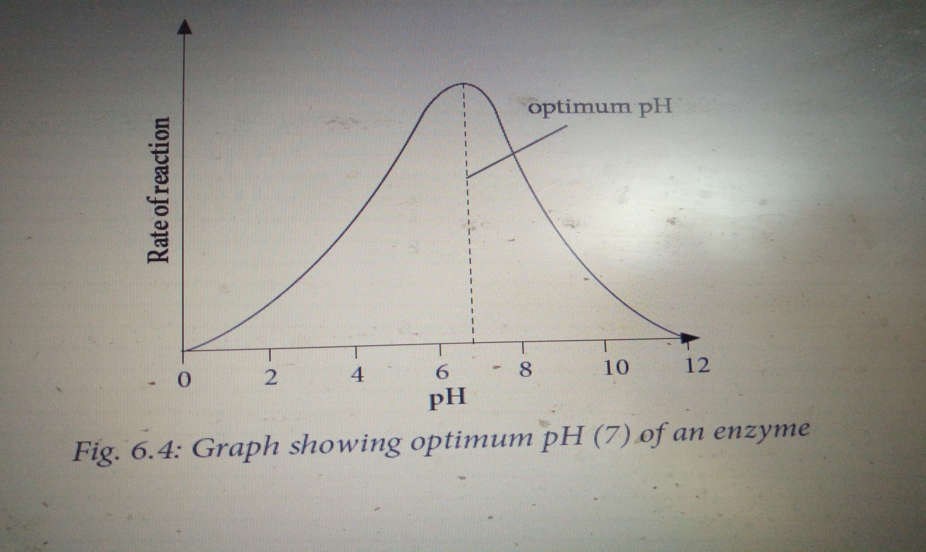
Factors affecting enzyme activity

Slide 169
Factors affecting enzyme activity
c) Enzyme concentration: When the concentration of enzymes increases , the rate of reaction increases as well.
d)Substrate concentration: When the substrate concentration increases , the rate of reaction increases as well.
e)Presence of inhibitor: Presence of inhibitors reduce the rate of reaction because they compete with substrate to active sites.
f) Surface area: When surface area is large, the rate of reaction increases.

Slide 170
Importance of enzymes in all living organisms
Lesson 1 & 2: Importance of enzymes in all living organisms in terms of reaction speed necessary to sustain life.
Enzymes facilitate chemical reactions of breaking down large molecules in the body.
Ex: During digestion.
Enzymes facilitate chemical reactions of synthesis to take place.
Ex: During photosynthesis
Enzymes are important in germination of maize by converting large molecules ( starch) into small molecules ( Glucose) to be used as source of energy.

Slide 171
Mode of action of enzymes
Lesson 3 :Mode of action of enzymes in terms of shapes and interactions with substrate and products.
Learning objective:
Appreciate the importance and specificity of enzymes in speeding up reactions.
Enzymes are very specific in nature. This means that they can only catalyze a specific reaction.

Slide 172
A KEY AND LOCK MECHANISM IN ENZYME ACTIVITY.
Products
Substrate
Active site
Substrate – enzyme complex
Enzyme

Slide 173
A KEY AND LOCK MECHANISM IN ENZYME ACTIVITY.
The shape of the substrate must complement the shape of the enzyme’s active site. This enables fitting of the substrate into the enzyme active site and enables the substrate to be changed into products.
Active site is where the substrate fits during the reaction.
The substrate must fit into the active site of an enzyme for a reaction to take place.

Slide 174
Unit 7: Photosynthesis.
Lesson 1: The necessity for chlorophyll, light energy and carbon dioxide and water for photosynthesis.
Learning objectives:
Define and state the word equation for photosynthesis.

Slide 175
Definition of photosynthesis
Photosynthesis refers to the process by which green plants make their own food and oxygen using carbon dioxide and water under sunlight.
Autotrophs are organisms that make their own food.
Autotrophs contains chlorophyll that captures solar energy.
Raw materials of photosynthesis are:
Water and carbon dioxide.
Products of photosynthesis are: Glucose and Oxygen

Slide 176
Word equation and chemical equation of for photosynthesis
Word equation for photosynthesis is as follow:
Water + Carbon dioxide Sun light glucose + oxygen
chlorophyll
Chemical equation for photosynthesis is as follow:
Light energy
6CO2(g)+ 6H2O(l) C6H12O6(S) + 6 O2 (g)
Chlorophyll
Water is from the soil and serves as a raw material.
Carbon dioxide is from the atmosphere and serves as a raw material.
Sunlight is from the sun and serves to split water molecules.
The chlorophyll is a green pigment found in chloroplasts. Chloroplast is an example of a plastid.

Slide 177
Experiment to show that oxygen is produced during photosynthesis.
A beaker
Sunlight
Elodea plant
NaHCO3(aq)
NaHCO3(aq)
A
B
N.B Set up A is in dark place.

Slide 178
Experiment to show that oxygen is produced during photosynthesis
Observation:
Bubbles of gas given off/ produced/ released from set up B is oxygen. Oxygen relights a glowing splint.
NaHCO3 provides CO2 necessary for photosynthesis.
There is no oxygen produced in set up A because no sunlight to be used in photosynthesis.

Slide 179
Necessary conditions or requirements for photosynthesis
Certain conditions are necessary. These conditions include the presence of:
Light energy
Carbon dioxide
Water
Chlorophyll

Slide 180
To investigate the necessity of carbon dioxide in photosynthesis.
Sun lights
NaHCO3(aq)
SET UP A

Slide 181
To investigate the necessity of carbon dioxide in photosynthesis.
polythene bag
Sunlight
NaOH /KOH
SET UP B

Slide 182
To investigate the necessity of carbon dioxide in photosynthesis
Observations:
1. When you detach leaves from each setup and test for the presence of starch:
In set Up A, There is the presence of starch because all necessary conditions are available.
In set up B , There is no starch because there is no CO2 for photosynthesis. NaOH absorbs CO2
2. The role of NaHCO3(aq) is to produce CO2(g) while NaOH absorbs CO2

Slide 183
Limiting factors of photosynthesis.
Lesson 2,3&4: Limiting factors of photosynthesis.
Learning objectives:
Mention and explain limiting factors for photosynthesis.
A limiting factor is a variable which limits the rate of photosynthesis.

Slide 184
Limiting factors of photosynthesis.
The limiting factors of photosynthesis include:
a. Light intensity: In darkness, plants cannot photosynthesize food at all. In low light intensity, the rate of photosynthesis is low. But as light intensity increases, the rate of photosynthesis also increases.

Slide 185
Limiting factors of photosynthesis
A graph showing effect of light intensity on rate of photosynthesis

Slide 186
Limiting factors of photosynthesis
Between the points A and B , Increase in light intensity leads to an increase in the rate of photosynthesis. Light is therefore a limiting factor.
Between B and C , the plant cannot photosynthesize food.
b. Carbon dioxide concentration: Increase in carbon dioxide increases the rate of photosynthesis. But this continues only to a certain point where rate of photosynthesis does not increase further with more carbon dioxide since other factors affecting photosynthesis become limiting.

Slide 187
Limiting factors of photosynthesis
Graph of effect of carbon dioxide concentration on the rate of photosynthesis

Slide 188
Limiting factors of photosynthesis
AB: Increase in concentration of carbon dioxide causes a rise in rate of photosynthesis.
BC: Increase in CO2 concentration does not cause a corresponding increase in rate of photosynthesis since other factors affecting photosynthesis become limiting.

Slide 189
Limiting factors of photosynthesis
c. Temperature : Photosynthesis is an enzyme- catalyzed reaction and is therefore affected by temperature.
If temperatures are low, plants photosynthesize very slowly.
If temperature increases, the rate of photosynthesis also increases.
Rate of photosynthesis is highest at optimum temperature. Further increase in temperature above /beyond optimum results to a decrease in rate of photosynthesis since enzymes are denatured or destroyed.

Slide 190
Limiting factors of photosynthesis
Effect of temperature on the rate of photosynthesis

Slide 191
Limiting factors of photosynthesis
AB : Increase in temperature causes a corresponding increase in the rate of photosynthesis. The rate of photosynthesis is highest at B. The point B corresponds to optimum temperature.
BC : Any further increase in temperature denatures the enzymes. Therefore the rate of photosynthesis declines or decreases because enzymes are destroyed.

Slide 192
Limiting factors of photosynthesis
d. Water : when water is in short supply, the stomata close. This lowers the exchange of gases between the leaf and the atmosphere. As a result, less carbon dioxide diffuses via the stomata into the leaf. This reduces the rate of photosynthesis.
When water decreases , the rate of photosynthesis decreases.

Slide 193
Adaptations of the leaf for photosynthesis
Lesson 1,2 and 3: Adaptations of the leaf for Photosynthesis.
Learning objective:
Explain how the internal and external structures of a leaf are adapted for photosynthesis.

Slide 194
Internal structure of the leaf

Slide 195
Function of internal parts of a leaf
Cuticle prevents water loss.
Palisade mesophyll: Site for photosynthesis.
Stomata: Allows gaseous exchange and allows transpiration.
Xylem: Transports inorganic substances such as water, ions..
Phloem transports organic substances such as sugar (glucose), vitamins and proteins.
Cell guards: Regulates the opening and closing of stomata.
Air spaces allow free movement of gases.

Slide 196
Adaptations of the leaf for photosynthesis
Adaptations of the leaf for photosynthesis are :
The leaf blade is flat to provide a large surface area for absorption of sunlight and carbon dioxide.
Most leaves are thin. This reduces the distance which carbon dioxide has to diffuse from the stomata to reach the photosynthesizing cells.
Leaves have vascular bundles ( xylem and phloem) which supply the cells with water and mineral salts and transports synthesized food to different parts of the plant respectively.
The leaf has stomata that allows gaseous exchange.

Slide 197
Adaptations of the leaf for photosynthesis
The leaf cuticle and epidermis are transparent and thin to allow easy penetration of light.
Presence of stomata on the leaves allows easy diffusion of carbon dioxide.
They also contain many chloroplasts which absorb maximum sunlight required for photosynthesis.

Slide 198
Importance of photosynthesis
Lesson 4: Importance of photosynthesis.
Learning objective:
Appreciate the process of photosynthesis.
All life on earth depends on photosynthesis directly or indirectly for the following reasons.
1. Photosynthesis is a source of energy for animals because plants make food which stores chemical energy.

Slide 199
Importance of photosynthesis
2. Photosynthesis provides oxygen in air which is used in respiration.
3. Photosynthesis makes carbon available to plants and animals . Carbon dioxide from the air is incorporated into synthesized food.
4. Photosynthesis prevents accumulation of carbon dioxide in the air by using it as a raw material. Removing CO2 form air by photosynthesis prevents global warming.

Slide 200
Mineral requirements for synthesis of proteins and chlorophyll
Lesson 1 & 2: Mineral requirements (nitrate ions for protein synthesis and magnesium ions for chlorophyll synthesis).
Learning objective:
Explain the importance of nitrates and magnesium in chlorophyll synthesis.
a)Magnesium ions :
Are required for the synthesis of chlorophyll, the pigment required in photosynthesis.
They are also needed for activation of many enzymes involved in the energy transfer processes.

Slide 201
Mineral requirements for synthesis of proteins and chlorophyll
(b) Nitrate ions
Nitrate ions are required by plants for protein synthesis and nitrates are used to make amino acids.
Deficiency of nitrates ions results to stunted growth.

Slide 202
Use and dangers of nitrogen and other fertilizers
Lesson 11: Use and dangers of nitrogen and other fertilizers.
Learning objective:
Describe the uses and dangers of fertilizers.

Slide 203
Harmful effects of nitrogen fertilizers to the environment
b) Harmful effects of nitrogen fertilizers to the environment.
1.Nitrogen fertilizers aid weeds and non-native plants tend to grow more readily with additional nitrogen supplies.
2. Excess nitrogen in the soil creates an imbalance of nutrients.
3.High amounts of nitrates in the soil results to increased acidity. This affects plants that require alkaline conditions to grow.

Slide 204
Harmful effects of nitrogen fertilizers to the environment
4. Nitrogen-polluted air, caused by nitrates from automobiles and industrial plants, results in acidification of the soil when acid rain falls.
5.Surface run-offs containing high amounts of nitrates enter into water bodies resulting to eutrophication.
6. Nitrogen is a soluble substance. It soaks deeply into the soil after a rainstorm or irrigation polluting water.

Slide 205
Unit 8:Transport of water, minerals and organic foods in plants.
Lesson 1: Transport system in plants.
Learning objective:
Identify xylem and phloem tissues from transverse sections and state their functions.
Plants synthesize organic substances ( food ) during photosynthesis. Those synthesized food are transported from source( leaves) to sinks ( roots or stem) to be stored.
Plants also transport inorganic substances ( water and minerals ) from the soil to the plant. Water from the soil is used in plant as a raw material during photosynthesis.

Slide 206
Necessity of transport in living things
Transport is necessary because:
Transport allows substances such as food to reach the cells.
Transport allows oxygen from their surroundings to reach the cells.
Transport allows waste substances to be eliminated from their bodies.

Slide 207
TRANSPORT OF MATERIALS IN A PLANT
Oxygen given off during photosynthesis
CO2 from atmosphere
Water and minerals from the soil
Sugar from leaves ( source to sinks)

Slide 208
Transport system in plants.
In plants, the transport system is made up of specialized tissues called vascular bundles. The vascular bundles contain
Substances that need to be transported in plants are:
Water required in photosynthesis.
Mineral salts used in various plant processes. two types of tissues: xylem and phloem.
Organic substances manufactured mainly by photosynthesis taking place in leaves

Slide 209
VASCULAR BUNDLES
Phloem and xylem tissues are found in the root, the stem and the leaves.
Phloem tissues transport food substances such as glucose and amino acids ( organic substances) from the leaves ( source) to other plant tissues where they are used or stored ( sinks)
Xylem tissues transport water and mineral salts ( from the soil) absorbed by the roots to different parts of the plant.

Slide 210
Water and minerals uptake
Lesson 2: Water and minerals uptake.
Learning objective:
Explain the mechanism by which water moves upwards in the xylem.
Water and mineral salts are absorbed from the soil through the root hair cells found in the roots.

Slide 211
Transverse section of dicot and monocot roots
Root hairs
Pith
Phloem
Xylem
Phloem
Xylem
Pericycle
Epidermis
a) A dicot root
b) Monocot root

Slide 212
Adaptations of the root hair cells
Adaptations of the root hair cells
(i) They are numerous so as to increase the surface area over which absorption of water and mineral salts occurs.
(ii) They are thin and fine so that they can penetrate the spaces in between the soil particles where water is found.

Slide 213
Absorption of water and how it moves from the root hair cell to the root xylem
Soil
Root hair
Water entering root hair by osmosis
Cortex
Xylem

Slide 214
Movement of water from the soil into root.
The cell sap in the vacuole of the root hair cell has a high concentration of salts and sugars It is therefore hypertonic to the water found between the soil particles due to this water moves by osmosis from the soil into the root.
Within the roots, water moves from cell to cell by the process of osmosis. This is because adjacent cells contain different water quantities.
Factors that influence the uptake of water :
Capillarity, root pressure, transpiration pull and cohesion of water molecules.

Slide 215
Movement of ions from the soil into root.
Roots have higher concentrations of ions as compared to the soil. This means that a root hair must take up these mineral ions against their concentration gradient. Ions are therefore transported by active transport which requires the expenditure of energy.
Mineral salts move together with water in form of a solution up the plant.

Slide 216
Source and sink of food products
Lesson 3: Source and sink of food products.
Learning objective:
Define and give examples of source and sinks in a plant.
Source is a part of a plant where organic substances ( photosynthates) are synthesized.
Ex leaves.

Slide 217
Source and sink of food products
Sinks are parts of plants where synthesized organic substances ( food) are stored or used.
Examples: Roots, young shoots, developing seeds, developing leaves, flowers and fruits,
Notice: Leaves are sinks when they are young and become sources later.

Slide 218
Transpiration.
Lesson 4: Transpiration.
Learning objective:
Describe transpiration and its effects.
Transpiration is the evaporation of water from the plant surface mainly through the leaf.
Transpiration is important because:
It cools the plant on hot days.
It also assists the movement of water and mineral salts up the plant.

Slide 219
Transpiration.
Leaves contain small pores called stomata on their surfaces, which allows the exchange of respiratory gases as well as the loss of water in form of vapor.
If plants lose a lot of water than they can gain, they wilt. If this continues for a long period of time, they may die. Thus transpiration is always referred to as a necessary evil.

Slide 220
Leaf structure in relation to transpiration
Upper epidermis
Xylem
Palisade layer
Spongy mesophyll
Phloem
Lower epidermis
Stomata opening

Slide 221
Factors that affect the rate of transpiration
a) The environmental factors affecting transpiration are(They are also called external factors affecting transpiration)
Temperature : On a hot day, the temperature is high the rate of transpiration increases. On cold days the temperature , the rate of transpiration decreases
Wind :The faster the air moves, the faster the rate of transpiration. Plants will lose a lot of water during windy conditions as compared to calm conditions.

Slide 222
Factors that affect the rate of transpiration
Humidity : When humidity is very high, the rate of transpiration decreases.
Light intensity: The rate of transpiration is high when there is high light intensity because the stomata open more. When the intensity of light is low, the rate of transpiration is reduced because stomata opens less. Stomata close in darkness, therefore at night very minimal amounts of water is lost.

Slide 223
Factors that affect the rate of transpiration
b) Internal factors that affect transpiration.
They include;
Stomatal distribution.
Leaf surface area.
Presence of a cuticle.
The number of stomata on a leaf.
Notice: Transpiration is measured using an instrument known as a potometer.

Slide 224
Adaptations of plants to different environment conditions.
Lesson 1 & 2: Adaptations of plants to different environment conditions.
Learning objective:
Explain the adaptations of desert plants.
Characteristics that enable a plant to survive in its specified habitat are called adaptations.

Slide 225
Adaptations of Xerophytes plants to dry areas
a) Xerophytes : Plants that grow in dry areas such as in desert. Ex: Cactus and Aloe vera.
Adaptations of desert plants.
They have a high ability to absorb water from the soil.
Their roots are usually more developed and grow deep into the soil.
They have water storage tissues.
They have hairs that trap damp air near the leaf surface causing saturation.

Slide 226
Adaptations of Xerophytes plants to dry areas
Xerophytes have very few stomata which are located on the lower epidermis away from the direct heat of the sun.
Some have stomata that opens during the night and close during the day.
Some shed their leaves during the dry season.

Slide 227
Adaptations of Xerophytes plants to dry areas
Cactus have tissues that store water

Slide 228
Adaptations of mesophytes to their habitats
b) Mesophytes: Plants that grow under average conditions of water supply and temperature.
Adaptations of mesophytes to their habitats :
They have thin leaves, which ensure rapid diffusion of gasses from the stomata.
They have stomata on the upper and lower leaf epidermis to allow for efficient gaseous exchange and also for transpiration.
They have flat leaf blades that provide a large surface area for absorption of light and carbon dioxide.

Slide 229
Adaptations of mesophytes to their habitats
They have thick transparent cuticles to prevent water loss.
They have a well developed root system with long tap or fibrous roots.
Their leaves have cells with chlorophyll so that photosynthesis takes place.
They have a well developed root system with long tap.

Slide 230
Adaptations of Xerophytes plants to water or wet places
c) Hydrophytes
Hydrophytes are plants that live in water or in very wet places. Ex : Water hyacinth , water lilies

Slide 231
Adaptations of Xerophytes plants to water or wet places
Their roots are not well developed.
They have many air spaces in the stem and leaf tissue.
They contain little xylem.
They have less stomata.

Slide 232
Translocation of organic foods.
Lesson 3: Translocation of organic foods.
Learning objective:
Explain how translocation takes place.
Translocation is the movement of organic products of photosynthesis from leaves to other parts of the plant through phloem.
They move from their source such as leaves ( site of production) to sinks such as roots ( site of storage or usage).
It means translocation occurs form the source to the sink.

Slide 233
Unit 9: Gaseous exchange in humans and plants.
Lesson 1: Characteristic features of respiratory surfaces and mechanism of breathing in humans.
Learning objective:
Explain the characteristics and adaptive features of gaseous exchange surface.
Define gaseous exchange and why it is an important process.

Slide 234
Gaseous exchange
Gaseous exchange is the biological process through which oxygen and carbon dioxide are transported through the body of an organism.
Animals always take in oxygen and release carbon dioxide during respiration. Plants take in CO2 and release O2 and occurs by diffusion.
Gaseous exchange is exchange of respiratory gases in animals and plants.

Slide 235
Importance of gaseous exchange
Gaseous exchange is important because:
It removes wastes from the organisms.
It allows the supply of oxygen to tissues.

Slide 236
Respiratory surfaces and their characteristics
Respiratory surfaces parts of the body over which gaseous exchange occurs.
Ex: Lungs or alveoli in mammals, Gills in fish, Skin in frogs
Characteristics of respiratory surfaces are:
Respiratory surfaces are moist to dissolve gases as they diffuse across it.
Respiratory surfaces have thin walls for faster diffusion of gases across it.
Respiratory surfaces have a large surface area for maximum gaseous exchange.
Respiratory surfaces have are surrounded by blood capillaries to quickly transport gases to and from the cells.

Slide 237
Mechanism of breathing in humans
Breathing is intake and out take of respiratory gases. Or breathing is the process that brings air into the lungs and removes it again.
Breathing involves two phases called inhalation and exhalation.
i) Inhalation or inspiration. This is taking air into the lungs.

Slide 238
Two phases of breathing.
During inhalation,
The diaphragm muscles contract causing it to flatten.
In the ribs region, the external intercostal muscles contract.
The rib cage move upwards and outwards.
Air rushes through the air passages into the lungs.

Slide 239
Mechanism of breathing in humans
ii) Exhalation/expiration: This is (breathing out) or The process which expels air out of the lungs.
During exhalation:
The diaphragm muscle relaxes regain its dome shape.
Rib cage moves downwards and inwards.
The external intercostal muscles relax.
The volume of the chest cavity decreases.
The pressure increases inside and forces air out of the lungs.

Slide 240
Human breathing system
Pleural membrane
Larynx
Trachea
Intercostal muscle
Brancioles
Alveoli
Diaphragm

Slide 241
Gaseous exchange at the alveoli and respiratory diseases, their causes, spreads and preventive measures.
Lesson 2: Gaseous exchange at the alveoli and respiratory diseases, their causes, spreads and preventive measures.
Learning objective:
Describe gaseous exchange in the lungs and alveolus.

Slide 242
Gaseous exchange in the alveolus
Deoxygenated blood coming fro pulmonary artery
Oxygenated blood coming to pulmonary vein
CO2 out
O2 in
Red blood cells
Thin wall of capillary

Slide 243
Features of alveolus that enables gaseous exchange.
The alveolus is a suitable for gaseous exchange because:
It has a very large number of alveoli to increase their surface area for gaseous exchange.
It has a very thin wall across which gases diffuse between it and the blood.
It is lined with a thin film of moisture to dissolve the diffusing gases.
It is supplied with blood which carries the gases being exchanged.

Slide 244
Respiratory diseases, their causes, spreads and preventive measures
The respiratory system is affected by many diseases and disorders:
i) Asthma
ii)Tuberculosis
iii) COVID-19
iv)Pneumonia
v) Influenza
Notice : Lung cancer attacks the lungs due to over smoking and lung cancer is not infectious disease because it in not caused by a microbe

Slide 245
Respiratory diseases, their causes, spreads and preventive measures
i.Asthma : This is a disease that comes about when the air passages in the lungs suddenly narrow as a result of contraction of their smooth muscles. It is caused by allergens such as pollen grains, some type of proteins in milk, pet hairs, dust.
Symptoms of asthma
Difficulty in breathing. Breathing can feel so difficult or quick that the patient can faint.
Wheezing sounds when breathing.
Prevention: Avoid allergens.

Slide 246
Respiratory diseases, their causes, spreads and preventive measures
ii.Tuberculosis
Tuberculosis (TB) is caused by bacteria called Mycobacterium tuberculosis.
Signs and symptoms
Tuberculosis of the lungs starts with a dry cough followed by the spitting of blood, fever and sweating at night as the infection proceeds.
Prevention:
Overcrowding increases the risk of spread of tuberculosis.
Avoid taking raw milk. Boil all milk or drink pasteurized milk.
Immunization with B.C.G. vaccine in children.
Isolating patients

Slide 247
Respiratory diseases, their causes, spreads and preventive measures
iii) COVID-19: It is a disease caused by a corona virus.
Signs and symptoms : Cough, fever, tiredness, difficulty in breathing and persistent pain in chest
Spread: Droplets of saliva, discharge from the nose
coughing and sneezing of infected people, physical contact with infected people.
Prevention: Avoid physical contact, wash hands regularly. Isolation of infected people, quarantine of people who met infected people, confinement of people who are not yet infected, Lockdown of cities or towns counties where cases of COVID-19 was identified.

Slide 248
Structure of a leaf and gaseous exchange in plants.
Lesson 3: Structure of a leaf and gaseous exchange in plants.
Learning objectives:
Explain the process of gaseous exchange in plants.
Gaseous exchange in plants takes place though the
Stomatal pores of the leaves whereby O2 is released and CO2 is captured.

Slide 249
Gaseous exchange in plants.
Stomata are pores between guard cells. They are found on the upper or lower epidermis or both. Stomata allow:
Entry of carbon dioxide into the leaf for photosynthesis.
Exit of oxygen.
Evaporation of water.

Slide 250
Open stoma
Epidermal cell
Stomatal pore
Chloroplast
Guard cell controls opening and closing of stomata
Water entering guard cell
When water enters the stomata they open

Slide 251
Gaseous exchange in plants
When the stomata are open, Oxygen is concentrated in palisade cells diffuse out and carbon dioxide is concentrated in environment diffuse into of the leaf cells along their concentration gradient.
During photosynthesis, carbon dioxide is used up by the palisade cells, and oxygen is produced.

Slide 252
Gaseous exchange in the leaf of a terrestrial plant

Slide 253
Gaseous exchange
In large multicellular organisms such as human beings need a system of transport because most cells are deep inside the body. Diffusion alone is not enough to move gases across the large number of cells that lies inside .
In humans being, breathing is controlled by medulla oblongata in the brain which is sensitive to the concentration of carbon dioxide. When this exceeds a certain level the medulla oblongata stimulates the ribs and diaphragm to contract more rapidly.

Slide 254
Unit 10: Excretion in humans
Lesson 1: Need for excretion and the human excretory organs and their products.
Learning objectives:
Define and explain the need for excretion.
Name excretory organs and excretory products.

Slide 255
Excretion in humans
Excretion as the process by which organisms remove waste products of metabolism from the body.
The excretion is important for living things because:
Excretion ensures the balance of the organism’s internal body environment.
Excretion is the removal of wastes from the body of living things.

Slide 256
Excretory organs and excretory products.
EXCRETORY ORGAN | EXCRETORY PRODUCTS
Skin | Sweat, urea, lactic acid, excess salts
kidney | Urine ( urea, salts, nitrogenous wastes, water
Lungs | CO2 , Water vapor
Liver | Bile, ammonia, urea and uric acid

Slide 257
Role of the liver in excretion and Structure of the human urinary system.
Lesson 2: Role of the liver in excretion and Structure of the human urinary system.
Learning objective
Describe the role of the liver in excretion.
Identify parts of the human urinary system.

Slide 258
Role of the liver in excretion
The excretory functions of the liver are described below:
1.The liver ensures deamination: The body cannot store proteins or amino acids. Surplus amino acids and proteins are broken down in the liver in a process called deamination to produce less harmful substances.
2.The liver ensures detoxification :The liver removes harmful substances such as drugs and hormones from the blood. Toxic substances are removed from the body or converted to less dangerous. Ex: Hydrogen peroxide is converted to water and oxygen.
2H2O2 (aq) Catalase 2H2O (l) + O2(g)

Slide 259
Role of the liver in excretion
3.The liver eliminates of haemoglobin from old worn out red blood cells. The pigments of haemoglobin are further broken down and eliminated in the bile, giving urine its characteristic of having yellow color.
4.The liver eliminates sex hormones and cholesterol after having performed their functions.

Slide 260
Structure of the human urinary system
Vena cava
Aorta
Left renal vein
Right kidney
Left urinary artery
Right ureter
Sphincter muscles
Urinary bladder
Urethra

Slide 261
Function of parts of the urinary system
The urinary system keeps everything in balance by removing waste, such as urea, extra salt, extra water and other things the body does not need.
1.The kidneys:
Filter the blood by removing wastes and forms urine.
Keep substances stable in the blood.
Make erythropoietin, a hormone which helps make red blood cells.
Make vitamin D active.
Regulate blood pressure

Slide 262
Function of parts of the urinary system
2. Ureter:
Carries urine from the kidney to the bladder.
3. Bladder:
Stores urine until is emptied through the urethra.
4.Sphincter muscle
Prevent urine from leaking.
5.Urethra
Allows urine to pass outside the body under control of the brain.

Slide 263
Structure of human kidney and Process of urine formation
Lesson 3: Structure of human kidney and Process of urine formation.
Learning objectives:
Outline the structure of kidney and describe a nephron.
Describe the process of urine formation.

Slide 264
Structure of human kidney
Cortex
Renal artery
Renal vein
Medulla
Pelvis
Ureter

Slide 265
The nephron
A nephron is the functional unit of the kidney where filtration of blood takes place.
The nephron has the following parts:
1.Bowman’s capsule,
2. The proximal convoluted tubule
3. A U-shaped called loop of Henle
4.A distal convoluted tubule.
5.The collecting duct.

Slide 266
Structure of the nephron
Afferent arteriole
Proximal convoluted tubule
Bowman capsule
Distal convoluted tubule
Collecting duct
Loop of Henle

Slide 267
Urine formation
Urine formation occurs through these steps:
1.Ultrafiltration : Separation the useful substances from no useful substances. It takes place in glomerulus.
2. Selective reabsorption: Returning of useful substances back into the blood so that they are not lost.
Ultrafiltration occurs as follow:
Blood with high pressure enters the glomerulus by afferent arterioles and forces water, mineral ions and small molecules like glucose, amino acids and urea out of the glomerulus and forms glomerular filtrate.

Slide 268
Urine formation
Notice: The larger molecules in the blood, like blood proteins, white blood cells, red blood cells and platelets cannot pass through the capillary walls of the glomerulus. These remain in the blood and continue to flow to the efferent arteriole and back to the body.
Selective reabsorption occurs as follow:
As the glomerular filtrate passes along the nephron, some substances that are useful to the body are selectively taken back or reabsorbed into the blood capillaries network surrounding the nephron.

Slide 269
Urine formation
All amino acids and glucose are reabsorbed by active transport in the proximal convoluted tubule and some salts and water are reabsorbed depending on how much of them the body still needs
No urea is reabsorbed into the blood.
Notice: Water is absorbed by osmosis and salts by active transport.
After the removal of useful substances during the selective reabsorption the remaining forms urine that is emptied to bladder.

Slide 270
Factors affecting concentration of urine and Practices that maintain healthy urinary system
Lesson 4: Factors affecting concentration of urine and Practices that maintain healthy urinary system.
Learning objective:
Develop good habits to maintain healthy urinary system.

Slide 271
Factors affecting concentration of urine
Factors that affect urine production
1. Amount of fluids taken: Large intake of fluids results in the production of large amounts of dilute urine.
2. Amount of salt taken Intake of a salty meal, decreases the volume of urine produced.
3. Weather
In hot and dry weather conditions, the body lose a lot of water through sweating which results in production of colored, little and smelly urine
During cold weather the frequency of urination increases because sweating is so minimal.

Slide 272
Factors affecting concentration of urine
4. Physical activity
During an exercise like running, jumping and playing, we sweat a lot. The kidney reabsorbs more water resulting in little, colored and smelly urine.
5. In take of alcoholic drinks: Alcohol prevents ADH from helping kidney not to lose water , hence causing too much production of urine.

Slide 273
Practices that maintain healthy urinary system
Practices that maintain healthy urinary system are:
Drinking a lot of water, at least 10 glasses of water a day to flush out toxins in the body.
Exercising regularly to keep fit.
Avoid taking too many drugs especially pain killers.
Visit a doctor (urologist) regularly to check the health of the urinary system.
Avoid smoking and alcohol intake.

Slide 274
Unit 11: Joints and movement
Lesson 1: Types of joints.
Learning objective:
Differentiate between hinge joint and ball and, socket joint.
A joint is a point where a bone meets another bone or bones.
Joints allow movement and provide mechanical support.

Slide 275
KEY TERMS
Bone : This is a hard, tough connective tissue.
Cartilage : This is a skeletal connective tissue which is softer than a bone. It supports the trachea, nose, oesophagus and pinna of the ear.
Ligament: This is a fibrous tissue which join one bone to another. They are elastic to allow movement at a joint.
Tendon: This is a tough connective tissue which attaches a muscle to a bone. They are inelastic.
Muscle: This is a contractile tissue responsible for locomotion.

Slide 276
TYPES OF JOINTS.
1.Classification of joints according to Structure.
a) Cartilaginous joint: The bones are connected by cartilage.
b) Fibrous joint : The bones are connected by dense fibrous tissue rich in collagen.
c) Synovial joint: There is a space between the bones called synovial cavity that is filled with a fluid known as synovial fluid.

Slide 277
TYPES OF JOINTS.
2.Classification of joints according to how they function. (Functional classification )
(a) Immovable joints: Permit very little or no mobility.
(b) Movable joints: Allow some degree of movement. There are two categories;
Those which allow slight mobility.
Those which are freely movable.

Slide 278
Fixed joint
a) Fixed or immovable joints : These are joints that do not allow any movement. Ex: sutures
Sutures

Slide 279
Movable joints
b) Movable joints : These are joints that allow movement of body parts to take place.
i) Gliding joints :These joints consist of two opposing flat surfaces that allow slight amount of gliding motion. They have no fluid between them but instead have a larger cartilage between them known as intervertebral disc which reduces friction during movement. They are found in ankle, wrist

Slide 280
Gliding joints
Tibia
Tarsals
Fibula
Calcaneus
Talus/ankle bone

Slide 281
Synovial joints:
ii) Synovial joints: They have synovial fluid between them. The types of synovial include:
Saddle joints: Joint of the thumb.
Hinge joints allow movement back and forth movement as the only type of movement. Ex: joints at the elbow, knee and finger joints.
Pivot joints: They allow bones to rotates. Ex: Between the head of radius and the proximal end of the ulna.
Ball and socket joint :These types of joints allow the greatest flexibility of movement of all joints. EX: Hip and shoulder joints

Slide 282
Structure of a synovial joint.
Lesson 2: Structure of a synovial joint.
Learning objective:
Outline the function synovial fluid in the joint.

Slide 283
A synovial joint
Articular cartilage
Synovial cavity with synovial fluid
Notice: Synovial fluid provides lubrication and nourishments

Slide 284
Action of antagonistic muscles in movement of a hinge joint
Lesson 3: Action of antagonistic muscles in movement of a hinge joint.
Learning objective:
Demonstrate how antagonistic muscles bring about movement at the hinge joint.
The biceps and triceps are referred to as antagonistic muscles. They are found on the upper part of the forearm. To lift the arm, the biceps contracts while the triceps relaxes.

Slide 285
Action of antagonistic between biceps and triceps
The joint action in the upward movement of the arm is flexion resulting to the decreasing of the joint angle. Biceps muscles are therefore called flexor muscles.
To straighten the arm, triceps muscles contract while biceps relaxes; the joint action is extension that results to increase in the joint angle.

Slide 286
Action of antagonistic between biceps and triceps
Biceps relax
Triceps contract
Extended arm

Slide 287
Practices that promote healthy bones and joints.
Lesson 4: Practices that promote healthy bones and joints.
Learning objective:
Develop good habits that maintain safety of the body joints.

Slide 288
Practices that promote healthy bones and joints.
Practices that promote healthy bones and joints are:
Eating food rich in calcium( milk , green vegetables) to keep the bones healthy and strong.
Eating food rich in Vitamin C such as oranges, lemons, watermelon which is necessary in repairing tissues.
Avoiding alcohol consumption. Taking alcohol interferes with the body’s ability to absorb vitamins and minerals.
Avoiding smoking. Smoking has been shown to cause bone mass depletion.

Slide 289
Unit 12: Infectious diseases
Lesson 1: Pathogens.
Learning objectives:
Define pathogen and give examples of pathogens.
Pathogen: This is any disease-causing microorganism.
Ex: Bacteria that cause disease, protozoa that cause disease , viruses that cause disease that cause disease . Pathogens are also known as germs.

Slide 290
Transmission of infectious diseases
Lesson 2: Transmission of infectious diseases
Learning objective:
Define transmissible/ infectious or communicable disease and host.
Infectious diseases are also known as communicable diseases. They are diseases that are transmitted from one person to another.
EX: COVID-19.
Infectious diseases are caused by harmful micro-organisms. Examples of micro-organisms include viruses, fungi, protozoa and bacteria.

Slide 291
Key terms about infectious diseases
Host: This is an organism that harbours a disease-causing micro-organism. Ex: water snails are hosts to schistosomes that causes bilharzia.
Vector: This is a living organism that can transmit infectious diseases from one organism to another. Ex: Female anopheles mosquito is a vector to the plasmodium parasite malaria
Carrier: This is a person who has been infected but develops no signs or symptoms. This person is capable of transmitting the disease to other people.
Signs: These are visible expressions brought about by a disease, for example, red spots on the body.
Symptoms: A physical or mental feature that is regarded as indicating a condition of disease. Ex headache , dizziness

Slide 292
Transmission of infectious diseases
Infectious diseases can be spread or transmitted in several different ways:
1.Transmission through the air:
Ex: Air-borne diseases such as tuberculosis and common cold.
2. Transmission through the consumption of contaminated water and food.
Ex: Waterborne such as cholera, foodborne such as typhoid fever.

Slide 293
Transmission of infectious diseases
3. Transmission through blood transfusion or contact with contaminated blood.
Ex: HIV and AIDS
4. Transmission through physical contact with an infected person. Those diseases are termed contagious
Ex: Ringworms, Ebola and COVID -19
5. Transmission by vectors. They are termed
vector-borne diseases.
Ex: Sleeping sickness is spread by tsetse flies, malaria is spread by female anopheles mosquito.

Slide 294
Transmission of infectious diseases
6. Transmission through unprotected sexual intercourse with an infected person. These diseases are known as sexual transmitted infections (STIs).
EX: HIV and AIDS.

Slide 295
Defense against infection
Lesson 3: Defense against infection (first line of defense, second line of defense, immunity).
Learning objective:
Explain how the body’s defense mechanism can be enhanced by vaccination.
Immunity is the ability of the body to resist disease infection.
The first line of defense refers to the external defense system of the body that includes both physical and chemical defense lines that prevent harmful micro-organisms from entering the body.

Slide 296
The body's first line of defense mechanisms that prevent harmful micro-organisms from entering the body.

Slide 297
Body’s second line of defense
When pathogens get into the body, the body used second line of defense to fight infection. The immune system attacks the pathogens and destroy them using white blood cells known as phagocytes.
White blood cells known as phagocytes are adapted to fight pathogens because
Phagocytes release digestive enzymes which break down microbes before they can do any harm. (phagocytosis)
They also have the ability to change their shape. This enables them fit in the narrow capillaries hence reach the pathogens

Slide 298
Phagocytosis in white blood cells
Bacteria
Particles released from bacteria
White blood cell
Pseudopodia for engulf bacteria
Bacteria are destroyed/digested

Slide 299
Immunity
Immunity refers the ability of an organism to resist a particular infection or toxin by the action of specific antibodies or some white blood cells.
An antibody is a protein produced by the body’s immune system( white blood cells) when it detects harmful substances, called antigens.
Antigens are any substances such as micro-organisms, bacteria, fungi, parasites, viruses, and chemicals that cause immune response.

Slide 300
Types of immunity
1.Natural immunity: Natural immunity comes from the body itself. It is divided into two: active and passive natural immunity.
Active natural immunity may develop after recovering from a disease. The organism makes its own antibodies as a result of contact with antigen from disease-causing pathogen.
Passive natural immunity is immunity acquired by the foetus from the mother through the placenta and also through breast milk.

Slide 301
Types of immunity
2. Artificial immunity or acquired is obtained by introducing antigens into the body of an organism to protect the organism from a disease. It is divided into two: active and passive artificial immunity.
i) Active artificial immunity : This is immunity induced by introducing antigens into the body of an organism through the use of a vaccine. A vaccine contains antigens composed of living, dead or weakened pathogens.
Vaccine is used to stimulate the body to recognize certain disease antigens and respond to them. Vaccines usually do not cause the disease.

Slide 302
Types of immunity
ii) Passive artificial immunity is the transfer of immunity in the form of ready-made antibodies. This is immunity that comes from using antibodies produced in one organism to protect another organism from a specific disease.
Breastfeeding a baby give a passive immunity to the baby

Slide 303
Symptoms, prevention of common diseases
Lesson 1, 2 &3: Symptoms, prevention and control, treatment of common diseases (malaria, cholera, TB, Ebola and HIV/AIDS)
Learning objective:
Explain the symptoms, prevention and control of malaria, Ebola and HIV and AIDS.

Slide 304
Malaria
1.Malaria: Malaria is Caused by a protozoan parasite called Plasmodium(P. falciparum and P. vivax ) and is spread by spread through the bites of infected female Anopheles mosquitoes.
These groups are prone to developing a severe form of the disease, than others, include infants, children under 5 years of age, pregnant women and patients suffering from HIV and AIDS.

Slide 305
Symptoms of malaria
Symptoms of malaria
High fever and periodic chills that may be accompanied with sweating.
Frontal headache.
Pain in the joints.
General body weakness.
Lack of appetite and nausea that may be accompanied by vomiting.

Slide 306
Prevention of malaria
(i) Clearing bushes around homes.
(ii) Draining marshes, pools and stagnant water around homes. This destroys breeding places for mosquitos.
(iii) Spraying light used oil on stagnant water that cannot be drained. Oil sprayed on stagnant water kills mosquito larvae by suffocating them.

Slide 307
Prevention of malaria
iv) Spraying the inside walls of our houses with insecticides.
(v) Closing doors and windows during the evening time to prevent mosquitoes from entering. Windows can also be screened with window proof wire mesh.
(vi) Sleeping under a treated mosquito net.

Slide 308
Prevention of malaria
vii) Removing old tins, broken pots, polythene bags and other things that can hold water from the compound. This prevents mosquitoes from breeding.
(viii) Patients can be isolated during the infection period to prevent transmission to others.
(ix) Fish-eating mosquitoes can be introduced into ponds and pools to feed on mosquito larvae and pupae.
(x) Preventative medicines can be taken regularly but upon prescription from a qualified medical doctor.

Slide 309
Cholera
Cholera : Cholera is an acute diarrhoeal infection caused by ingestion of food or water contaminated with the bacterium Vibrio cholerae.
Symptoms of cholera
(i) Severe watery diarrhoea and vomiting.
(ii) General body weakness.
(iii) Low blood pressure.
(iv) The patient loses weight rapidly.
(v) The patient develops wrinkled skin and sunken eyes because of dehydration.

Slide 310
Control and treatment of cholera
Control of cholera can be done by:
(i) Drinking water should be treated or boiled and stored properly.
(ii) Proper disposal of human wastes. A well-managed sewage disposal system in towns and use of latrines. in the rural areas.
(iii) Washing hands before and after eating and after visiting the toilet.

Slide 311
Control and treatment of cholera
iv)Covering cooked food to avoid contamination by house flies.
(v) Vaccination during epidemics or when one is visiting an infested area.
(vi) Cholera is treated using antibiotics. Prevention of dehydration also helps in the cure.

Slide 312
HIV and AIDS
3. HIV and AIDS.
HIV : This the Human Immunodeficiency Virus.
AIDS :This is Acquired Immune Deficiency Syndrome.
HIVV/AIDS is Spread or transmitted:
(i) By birth, from an infected mother to her unborn baby.
(ii) By having unprotected sexual intercourse with an infected person.
(iii) By transfusion of infected blood.
(iv) By sharing of unsterilized surgical and skin piercing instruments with infected people.

Slide 313
Prevention of HIV/AIDS SPREAD
The following are the ways through which a person can prevent himself or herself from contracting HIV/AIDS.
i) Abstaining from sex till marriage.
ii. Being faithful to one partner.
iii. Using condoms during sex.
iv. Mothers should give birth in hospitals and go for regular medical checkup.
v. Blood should be screened before transfusion.
vi. Avoid sharing piercing and cutting instruments like razorblades and safety pins.

Slide 314
Tuberculosis
4. Tuberculosis
Tuberculosis (TB) is caused by bacteria called Mycobacterium tuberculosis that most often affects the lungs.
Spread of TB: TB is spread when If a healthy person inhales germs from coughs, sneezes or spits of an infected people. TB is an airborne
People with low immune systems, such as people living with HIV and AIDS, malnutrition, diabetes, or people who smoke, have a much higher risk of being infected.

Slide 315
Prevention of tuberculosis
Isolate patients to prevent transmission of the disease to other people.
ii) Immunize children with tuberculosis vaccine known as BCG.
iii) Avoiding overcrowded places.
Drinking boiled milk. Some types of tuberculosis is transmitted from bovine.

Slide 316
Ebola
5.Ebola: Ebola is caused by a virus.
Ebola virus is introduced into the human body through contact with body fluids of infected animals such as chimpanzees, gorillas, fruit bats, monkeys, forest antelope.
Symptoms of Ebola virus disease.
Fever, fatigue, muscle pain, headache, vomiting, diarrhea and internal and external bleeding with blood oozing from the gums, ears and eyes.

Slide 317
Prevention of Ebola
Prevention of Ebola spread is done as follow:
(i) Avoid direct contact with wild animals like bats and chimpanzees.
(ii) Avoid direct contact with people showing signs of Ebola virus.
(iii) Use gloves and other protective clothing when handling Ebola patients.
(iv) Wash your hands regularly with soap and water.
(vi) Burial of the dead patients should be done by health workers.

Slide 318
Unit 13: Immunity and vaccination
Lesson 1: Antigens and antibodies.
Learning objective:
Explain how each pathogen has its own antigens.
Define active immunity, pathogen and antibody production in the body.
Use a diagram to illustrate antibody-antigen reaction sites.
Immunity is the Ability of the body to defend itself against foreign bodies and disease-causing micro-organisms.
The immune system is the system that is responsible for defending the body against diseases. Components of immune system are:

Slide 319
Antigens
Antigen: It is any substance that stimulates an immune response, activating the body to produce antibodies.
Types of antigens:
a)Foreign antigens: Antigens that come from outside the body. EX: All pathogens : viruses and micro-organisms such as bacteria and protozoa, and certain proteins in foods.
b) Self-antigens: Antigens come from within the body. Normally, the body is able to distinguish self from non-self.

Slide 320
Antibodies.
An antibody is a protein that is produced mainly by plasma cells to defend the body against pathogens.
Or An antibody is a protein produced by the body's immune system when it detects harmful substances, called antigens.
Antibody is used by the immune system to identify and neutralize pathogens such as bacteria and viruses.

Slide 321
Antigen–antibody reaction
An antigen and antibody reaction works like a lock and key mechanism. This means each antibody is specific to its own antigen it acts on.
Antibody
Antigen-antibody complex
Antigen

Slide 322
Defensive mechanisms used by antibodies
The role of antibody is to inactivate and tag antigens for destruction by phagocytes.
Defensive mechanisms of antibodies are :
i) Neutralization: Antibodies bind to and block specific sites on antigens; viruses and bacteria and prevent antigens from binding to sites of receptors on tissue cells. Antigens are later destroyed by phagocytes. If the antigen is a toxin produced by pathogenic bacteria , this toxin is neutralized by antibody.

Slide 323
Defensive mechanisms used by antibodies
b) Agglutination : Antibodies bind the same determinant on more than one antigen.
EX: When an antibody surrounds a virus, such as one that causes influenza, it prevents it from entering other body cells.
c) Precipitation: Soluble molecules are cross-linked into large insoluble complex. After which they fall out of solution, and are phagocytized
d) Plasma complement system- The antibodies coat infectious bacteria and then white blood cells will complete the job by engulfing the bacteria, destroying them, and then removing them from the body.

Slide 324
Immune response
Lesson 2: Immune response
Learning objective:
Differentiate the immune responses.
Definition: Immune response refers to the process by which the body recognizes and defends itself against bacteria, viruses and substances that appear foreign and harmful.

Slide 325
Types of immune system.
Lesson 3: Types of immune system.
Learning objective
Explain different types of immune response.
Types of immune system include:
Innate immune system: Innate immune system also called nonspecific immunity is the body defense system that one is born with. It consists of:
Physical epithelial barriers
Phagocytic leukocytes.
Dendritic cells.
A special type of white blood cells called a natural killer (NK) cell
Circulating plasma proteins.
Acid in the stomach and enzymes in tears and skin oils.

Slide 326
Types of immune system.
b) Adaptive immune system. It is known as acquired immunity is immunity that develops after exposure to various antigens. Adaptive immune system includes certain types of white blood cells, for example, lymphocytes. There are B and T type lymphocytes.
B lymphocytes are cells that produce antibodies. Antibodies attach to a specific antigen and present it to other immune cells for destruction.
T lymphocytes are cells that attack antigens directly and help control the immune response.

Slide 327
Immunization /Vaccination
Lesson 1 & 2: Vaccination and immunization.
Learning objective:
Advocate for vaccination and breastfeeding as a sustainable disease prevention method.
Definition: Immunization is the process by which an immune response is triggered by the administration of a vaccine towards an infectious disease.
A vaccine is a dead or inactive antigen introduced into the body to keep in memory and allows your body to react quickly and efficiently to future exposure to such antigen. It is used to prevent diseases.

Slide 328
Immunization or Vaccination
Immunization or Vaccination is important through the following ways:
Immunization allows our body to react quickly and efficiently to future exposure.
Reduce the developing the illness.
Immunization reduce the spread of the disease in the population.

Slide 329
Autoimmune response and Type 1 diabetes.
Lesson 3: Autoimmune response and Type 1 diabetes.
Autoimmunity is a condition whereby the immune system attacks and kills own cell.
Any disease that results from such an immune response is termed an autoimmune disease.
Complications from altered immune responses include:
i. Allergy or hypersensitivity
ii. Autoimmune disorders
iii. Immunodeficiency disorders
iv. Serum sickness
v. Transplant rejection

Slide 330
Autoimmune response and Type 1 diabetes.
Type 1 diabetes was initially known as juvenile diabetes or insulin-dependent diabetes mellitus.
It is a chronic condition in which the pancreas produces little or no insulin.
Insulin is a hormone needed to enable sugar (glucose) to enter cells to produce energy.
The pancreas is the organ responsible for controlling the amount of sugar (glucose) in the body.

Slide 331
Autoimmune response and Type 1 diabetes.
Beta cells are responsible for manufacturing insulin. Insulin released into blood regulates the amount of sugar in the body keeping it at normal levels.
When a virus attacks the body, T- cells start producing antibodies to fight against this virus.
The virus such as rotavirus that causes diarrhoea can have same antigens like those of the beta cells in the pancreas. In this case, the T-cells mistakenly recognize beta cells as foreign to the body. T-cells attack these Beta cells hence destroying them leading to diabetes mellitus.

Slide 332
Unit 14 Sexual behavior and sexual response
Lesson 1: Male and female sexual responses and Sexual stimulation (physical or mental) for physical response.
Learning objective:
Describe male and female responses to sexual stimulation.
The stages are in four phases as below.
i. Excitement phase: This is the initial stage of stimulation that gets the body ready for sex.
ii. Plateau phase : This is a phase that prepares both man and woman for orgasm
iii. Orgasmic phase :The orgasm is the climax of the sexual response cycle.
iv. Resolution phase : The body slowly returns to its normal level of functioning.

Slide 333
Puberty (boys and girls), sexual thought and feelings, love and care.
Lesson 2: Puberty (boys and girls), sexual thought and feelings, love and care.
Learning objective:
Identify The problems faced during puberty
Puberty is a period during which adolescents reach sexual maturity and become capable of reproduction.
During this period, Among challenges that teenagers face, include unwanted pregnancies and sexually transmitted diseases.

Slide 334
The problems faced during puberty
In males, the problems faced during puberty include:
Abuse of drugs and alcohol
Lack of respect for authority
Fighting among peer groups
Parental hatred
Poor hygiene and general body cleanliness.
This is a critical time where boys need guidance and counseling
Notice: Females may face unwanted pregnancy

Slide 335
People and sexual relationships and Sexual problems and disappointment
Lesson 3: People and sexual relationships and Sexual problems and disappointment.
Learning objective:
The following are forms of sexual relationships:
a) Exogamy: Since incest is a taboo in the Rwandan society, individuals are advised to find their mates outside their family circles.
b) Monogamy: This is a long-term relationship between a man and a woman in which none has other sexual partners.

Slide 336
Sexual relationships
c) Polygamy: This is a long term sexual relationship of having more than one wife or husband at the same time.
d) Casual relationships: This is an act of having sex with someone you do not have an attachment to.
e) Dating relationships: This is when two people (a boy and a girl) go out together

Slide 337
Sexual problems and disappointment.
The following are some of the sexual disappointments.
In males
a) Premature ejaculation: This is a condition whereby a man cannot delay ejaculation long enough to satisfy the woman.
b) Impotence: This is the inability to produce or maintain an erection. Impotence occurs as a result of fear, anxiety, disease such as diabetes and drug abuse.
c) Inflammation: Blockage of the urethra occurs as a result of an infection or due to swelling of the prostrate gland.

Slide 338
Sexual problems and disappointment.
In females
Vaginal discharges: This is any abnormal discharge from the vagina.
Functional disorders: This is the inability of a woman to experience sexual pleasure and satisfaction. This results from emotional problems, feeling of guilt and trauma.

Slide 339
Sexual behaviors are unacceptable in the Rwandan culture:
i) Incest: This is the act of having sex with a close relative.
ii) Homosexuality: This is where people of the same sex are engaged in a sexual relationship.
iii) Masturbation: The act of self-stimulation that leads to sexual satisfaction.
iv) Anal sexual intercourse: This is a type of sexual activity in which the penis is inserted into the anus.

Slide 340
Sexual behaviors are unacceptable in the Rwandan culture:
v) Rape: The act of forcing some one into sexual intercourse without consent.
vi) Adultery: Having sex outside wedlock.
vii) Fornication: Engaging in sex before marriage.
viii) Sex slavery: The act of taking advantage of vulnerable individuals in a forced commercial sex.
ix) Prostitution: Engaging in sexual relationships for financial gains.

Slide 341
Sexuality, age and culture and Violation of human rights .
Lesson 4: Sexuality, age and culture; and Violation of human rights .
Violation of human rights includes:
Sexual harassment or abuse.
Coercion and human trafficking.
Child sexual exploitation : Child sexual exploitation is a type of sexual abuse in which children are sexually exploited for money, power or status.
EX: Some children and young people are illegally taken into foreign countries for the purpose of sexual exploitation. This is part of human trafficking.

Slide 342
Sexuality, age and culture and Violation of human rights .
Sexual assault : Sexual assault is any forced or coerced sexual contact or behavior that happens without consent. includes rape and attempted rape, child molestation, and sexual harassment or use of threats.

Slide 343
Unit 15: Pregnancy prevention.
Lesson 1: Abstinence and Common myths about contraceptives.
Learning objective:
Identify effective ways of preventing unintended pregnancy.
Outline forms of contraceptive methods and their working mechanisms.
Demonstrate confidence in discussing different contraceptive methods.

Slide 344
CONTRACEPTIVES
Contraceptives are the things that are used to prevent occurrence of pregnancies.
Common myths about contraceptives
i. Birth control pills make women gain weight and can cause cancer.
ii. The birth control pill has to be taken at the same time every day.
iii. Mothers who breast feed do not need to be on birth control pill.

Slide 345
CONTRACEPTIVES
iv. Being on the pill for a long time makes it harder to get pregnant later.
v. Newer forms of birth control methods are not as safe as the older ones.
vi. Intra uterine device (IUD) should be used by women who already have children.
vii. It is unhealthy to use birth control to skip your period.
viii. A girl cannot get pregnant when she has sex for the first time.

Slide 346
Importance of using contraceptives:
Lesson 2: Importance of the use of contraceptive methods.
Learning objective:
Explain the role of contraceptives:
Importance of using contraceptives:
It allows couples to have their desired number of children, and control the spacing and timing of their births.

Slide 347
Natural contraceptive methods
Lesson 3: Natural contraceptive methods; calendar (cycle beads), billings, lactation amenorrhea.
Learning objective:
Outline forms of contraceptive methods and their working mechanisms.
Demonstrate confidence in discussing different contraceptive methods.

Slide 348
Advantages of natural contraception
Advantages of natural contraception
a) Effective method of birth control.
b) Have no negative health side effects.
c) An alternative for women who cannot or do not want to use hormonal methods.
d) Promotes positive body awareness.
e) Consistent with many religious beliefs and lifestyles.
f) Alerts women to reproductive health and fertility concerns.

Slide 349
Disadvantages of natural contraception
Disadvantages of natural contraception
a) Provides no protection from sexually transmitted infections.
b) Often difficult to find trained instructors.
c) Requires time to learn (usually 3 to 6 cycles).
d) Requires discipline and commitment to chart fertility signs and follow the rules to avoid pregnancy.
e) Times of abstinence from intercourse may be a challenge for some couples.

Slide 350
Types of natural contraception
Types of natural contraception
Abstinence : Sexual abstinence is the avoidance of vaginal intercourse.
Advantages of abstinence
a) Minimal risk of misuse.
b) Prevents transmission of STIs including HIV and AIDS.
c) No physical side effects.
d) No need to visit a health care provider.
e) No cost involved .

Slide 351
Types of natural contraception
b) Lactation Amenorrhea Method (LAM): It is used by a mother who has just given birth and is exclusively breastfeeding. This method is highly effective for the first six months after childbirth. The mother has to breastfeed the baby at least every four hours during the day and every six hours through the night.
c) Temperature method: It is a type of natural family planning where a woman measures her basal body temperature: It is believed that ovulation may cause a slight increase in basal body temperature.

Slide 352
Types of natural contraception
d) Calendar method : Calendar method is also known as Rhythm method or cycle beads.

Slide 353
The Billings Ovulation Method
f) The Billings Ovulation Method: Observing daily vaginal discharge to determine fertile period.

Slide 354
Artificial contraceptive methods
Lesson 4: Artificial contraceptive methods.
Learning objective:
Demonstrate confidence in discussing different contraceptive methods.
i) Barrier methods
Use of male condom :
Advantages of using condoms
(i) It is easy to use.
(ii) Affordable
(iii) It offers the protection against sexually transmitted infections
Disadvantages
(i) A new condom is required every time one engages in sex.
(ii) If used improperly it can bust, this could lead to unwanted pregnancy or transmission of STIs.

Slide 355
Artificial contraceptive methods
c) Spermicide : Spermicide is a birth control method that contains chemicals that stop sperms from fertilizing the ova.
Disadvantages:
It does not protect against STIs.
d) The Diaphragm: This is a rubber cap inserted into the vagina to cover the cervix

Slide 356
Artificial contraceptive methods
ii) Hormonal based contraceptives:
a) The Pill : It is taken orally in form of a tablet, every day at almost the same time.
Disadvantage:
The pill does not provide any protection against STIs .
b) Contraceptive Injections : This is an injection that contains artificial progesterone (progestin).
Disadvantage:
Contraceptive injections do not protect against STIs.

Slide 357
Artificial contraceptive methods
c) The contraceptive implant : The implant offers long term protection. The contraceptive implant contains progestin (progesterone).
Disadvantage:
The implant does not protect against STIs.
d) The vaginal ring : The vaginal contraceptive ring is a small, transparent plastic ring that is inserted in the vagina .The ring contains the same hormones as the contraceptive pill (progesterone and oestrogen),
Disadvantage:
The vaginal ring does not protect from STIs.

Slide 358
Artificial contraceptive methods
e) The contraceptive patch : The contraceptive patch is exactly the same thing as the contraceptive pill but in the form of a patch.
Disadvantage:
It provides the same effective protection against pregnancy.
f) Emergency contraception
Emergency contraception assists to stop pregnancy in cases of eventualities such as rape or unprotected sex.

Slide 359
Artificial contraceptive methods
iii) Non – hormonal based contraception methods.
The Intrauterine Device (IUD) : An intrauterine device (IUD or coil) is a small contraceptive device, often 'T'- shaped. It often contains either copper or hormones. It is inserted into the uterus.
Disadvantage:
It provides no protection against STIs.

Slide 360
Artificial contraceptive methods
Permanent contraception methods
i) Vasectomy
This involves tying off and cutting the tubes that carry sperms; the vas deferens. It provides no protection against STIs and the effects are permanent

Slide 361
Artificial contraceptive method
ii) Tubal ligation : Surgical sterilization: This involves cutting and tying the fallopian tubes so that they cannot link the ovaries with the uterus any more. The effects are permanent.

Slide 362
Artificial contraceptive method
iii) Abortion : Abortion is the deliberate process of prematurely terminating a pregnancy.
The following are some of the reasons why a woman might decide to have an abortion:
Personal circumstances including risk to the wellbeing of existing children.
Health risk to the mother.
A high chance that the baby will have a serious abnormality either genetic or physical.

Slide 363
Menopause
Menopause
This is a term used to describe that state when a woman stops having monthly periods and is no longer able to get pregnant naturally
Common symptoms include:
a. Night sweats
b. Vaginal dryness and discomfort during sex
c. Difficulty in sleeping
d. Reduced sex drive (libido).
e. Problems with memory and concentration

Slide 364
Unit 16: Reducing risk of STIs and HIV.
Lesson 1: Transmission of STIs (chlamydia, gonorrhea and syphilis).
Learning objective:
Explain how STIs are transmitted
STIs is defined as Sexually Transmitted Infections.
EX: Chlamdia, gonorrhoea, syphillis and, HIV and AIDS
STIs are transmitted by infected persons to healthy persons during sexual intercourse.

Slide 365
Sexually Transmitted Infections (STIs)
Chlamydia:
Cause: The bacterium Chlamydia trachomatis.
Spread/transmission:
Oral, vaginal or anal sex, and also through touch, for example, touching the eyes with a contaminated hand.
Prevention:
Avoid Oral, vaginal or anal sex.

Slide 366
Sexually Transmitted Infections (STIs)
Signs and symptoms of chlamydia
In males
Pain when passing out urine.
White discharge from the penis.
The testicles may be painful or swollen.
Swelling of skin around the anus.
In females
Painful and frequent urination.
Smelly yellowish and abnormal vaginal discharge.
Pain in the lower abdomen.
Swollen skin in the vagina or around the anus.
Treatment
Chlamydia is easily treated using antibiotics.

Slide 367
Sexually Transmitted Infections (STIs)
2.Gonorrhoea :
Cause: A bacterium called Neisseria gonorrhoeae.
Spread/Transmission:
Sexual contact with the penis, vagina, mouth or anus of an infected partner.
Gonorrhoea can also be spread from mother to baby during childbirth.
Prevention: Avoid unprotected sex.

Slide 368
Sexually Transmitted Infections (STIs)
Signs and symptoms of gonorrhoea
In males:
A burning sensation when urinating.
A white, yellow, or green discharge from the penis.
Painful or swollen testicles (although this is less common).
In females:
Painful or burning sensation when urinating.
Increased vaginal discharge.
Vaginal bleeding between periods
Treatment
Gonorrhea can be treated using antibiotics like penicillin.

Slide 369
Sexually Transmitted Infections (STIs)
3. Syphilis.
Cause: A bacteria called Treponema pallidum.
Spread/Transmission: Direct contact with a syphilitic sore, known as a chancre and during vaginal, anal or oral sex with infected person.
Signs and symptoms:
Rashes on the skin and mild fever, paralysis, insanity, blindness
Treatment : Antibiotics like penicillin, erythromycin or tetracycline are used to treat syphilis

Slide 370
SOME COMMON SIGNS AND SYMPTOMS IN MEN AS WELL AS IN FEMALES DURING STIs
1.A burning sensation when urinating.
2.Painful or swollen of genital organs.
3. Painful during urination.
4. Foul discharge.
5. Colored discharge from genital organs.
(Vagina or penis).
6. Painful sensation during sexual intercourse.

Slide 371
Transmission of HIV infection and ways of reducing STIs and HIV
Lesson 2: Transmission of HIV infection and ways of reducing STIs and HIV
Learning objective:
Appreciate behaviors that reduce the risk of STIs and HIV transmission.
HIV: Human Immuno Virus: It is the virus that causes AIDS .
AIDS: (Acquired immune deficiency syndrome).

Slide 372
Transmission of HIV infection
(i) By birth, from an infected mother to her unborn baby.
(ii) By having unprotected sexual intercourse with an infected person.
(iii) By transfusion of infected blood.
(iv) By sharing of unsterilized surgical and skin piercing instruments with infected people.

Slide 373
WAYS OF REDUCING STIS AND HIV
The following are the ways through which a person can prevent himself or herself from contracting STIs and HIV.
i) Abstaining from sex till marriage.
ii. Being faithful to one partner.
iii. Using condoms during sex.
iv. Mothers should give birth in hospitals and go for regular medical checkup.
v. Blood should be screened before transfusion.
vi. Avoid sharing piercing and cutting instruments like razorblades and safety pins.
Vii) Get a vaccination for hepatitis B.

Slide 374
Treatments of STIs and HIV infection.
Lesson 3: Treatments of STIs and HIV infection.
Learning objective:
Explain the treatment of STIs.
Bacterial STIs can be cured using antibiotics.
Viral STIs cannot be cured, but can be managed.
Ex: There is a vaccine against hepatitis B, but it will not help if you already have the disease.
HIV cannot be cured but can be managed.
Antiretroviral therapy (ART) is the use of HIV medicines to treat HIV infection.

